Slide 1
COC 2
Setup Computer Networks

Slide 2
What is Computer Network?
Two or more computers connected together through a communication media form a computer network.
The computers are connected in a network to exchange information and data. The computers connected in a network can also use resources of other computers.

Slide 3
Computer Network Components
There are different Components of a Network. The following are the basic components of a Network:
Server Client Media Network Adapter | Resources User Protocols

Slide 4
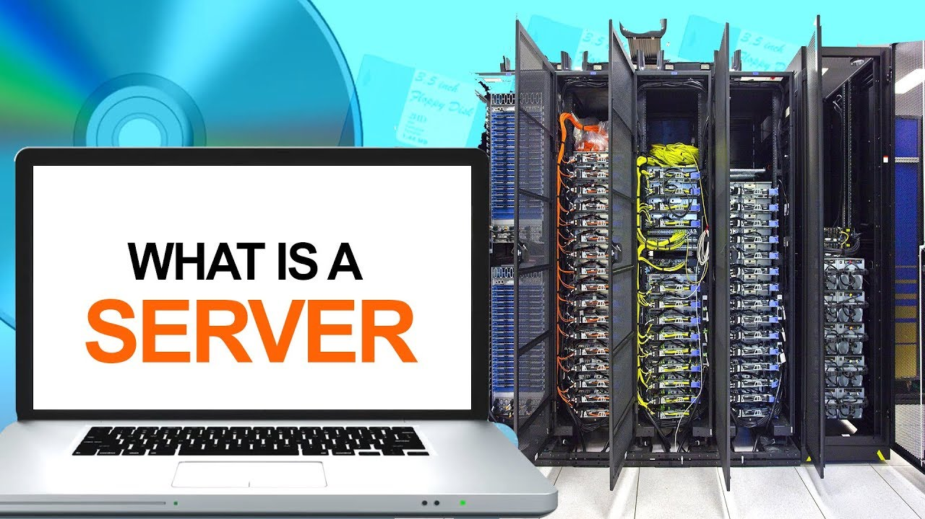
Server
Powerful computers that provides services to the other computers on the network
The function of a computer server is to store, retrieve and send or "serve" files and data to other computers on its network. Many businesses of all sizes use a local network or "intranet" in their office facilities.
Notes:
Powerful computers that provides services to the other computers on the network
The function of a computer server is to store, retrieve and send or "serve" files and data to other computers on its network. Many businesses of all sizes use a local network or "intranet" in their office facilities.

Slide 5
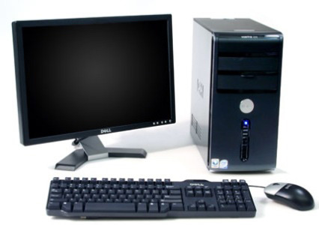
Client Computer
Computer that uses the services that a server provides the client is less powerful than server computer or terminal (called a CLIENT) can search simultaneously a number of databases maintained on heterogeneous computers (called servers
Notes:
Computer that uses the services that a server provides the client is less powerful than server
…computer or terminal (called a client) can search simultaneously a number of databases maintained on heterogeneous computers (called servers). The latter are located at different geographic sites, and their databases contain different data types and often use incompatible data formats. The simultaneous, distributed search is possible because clients and servers…

Slide 6
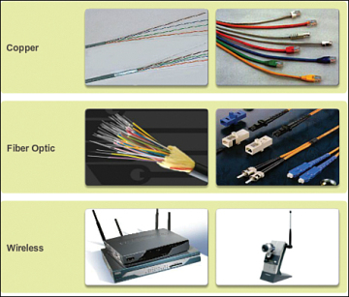
Media
A physical connection between the devices on a network
Communication across a network is carried on a medium. The medium provides the channel over which the message travels from source to destination.
Modern networks primarily use the following three types of media to interconnect devices and to provide the pathway over which data can be transmitted:
Metallic wires within cables
Glass or plastic fibers (fiber-optic cable)
Wireless transmission
Notes:
A physical connection between the devices on a network
Communication across a network is carried on a medium. The medium provides the channel over which the message travels from source to destination.
Modern networks primarily use the following three types of media to interconnect devices and to provide the pathway over which data can be transmitted:
Metallic wires within cables
Glass or plastic fibers (fiber-optic cable)
Wireless transmission

Slide 7
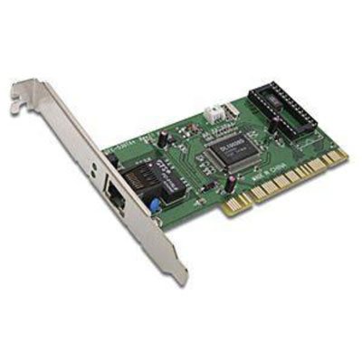
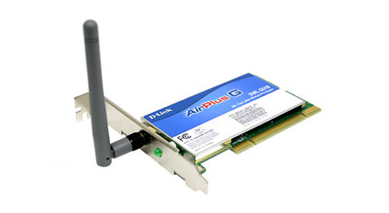
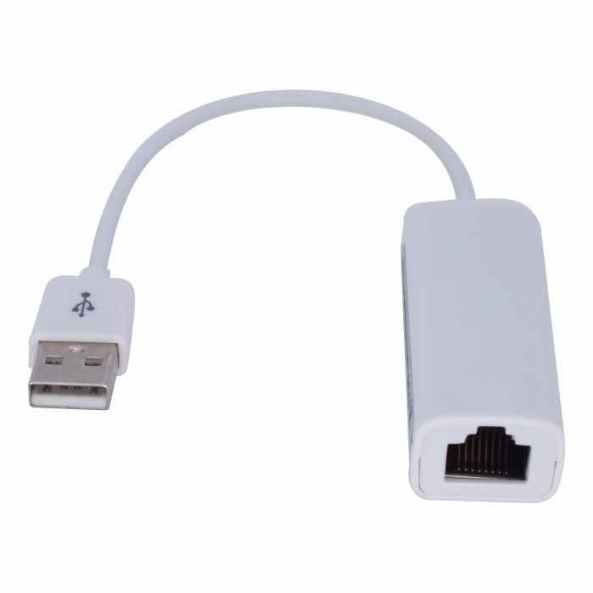
Network Adapter
Network adopter or network interface card (NIC) is a circuit board with the components necessary for sending and receiving data. It is plugged into one of the available slots on the Pc and transmission cable is attached to the connector on the NIC.
A network adapter is the component of a computer's internal hardware that is used for communicating over a network with another computer. It enable a computer to connect with another computer, server or any networking device over an LAN connection. A network adapter can be used over a wired or wireless network.
Notes:
Network adopter or network interface card (NIC) is a circuit board with the components necessary for sending and receiving data. It is plugged into one of the available slots on the Pc and transmission cable is attached to the connector on the NIC.
A network adapter is the component of a computer's internal hardware that is used for communicating over a network with another computer. It enable a computer to connect with another computer, server or any networking device over an LAN connection. A network adapter can be used over a wired or wireless network.

Slide 8
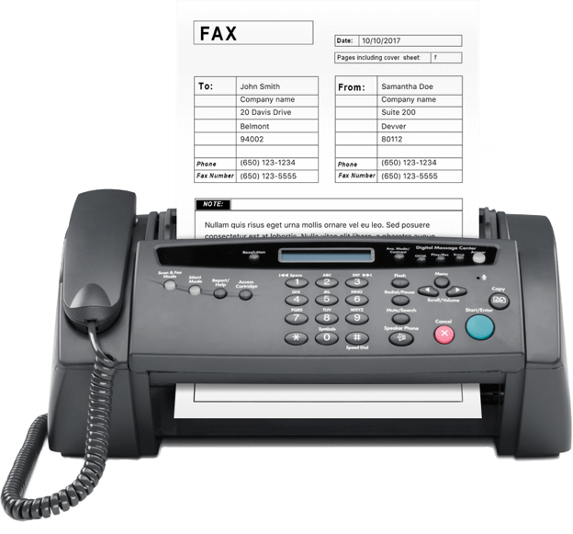
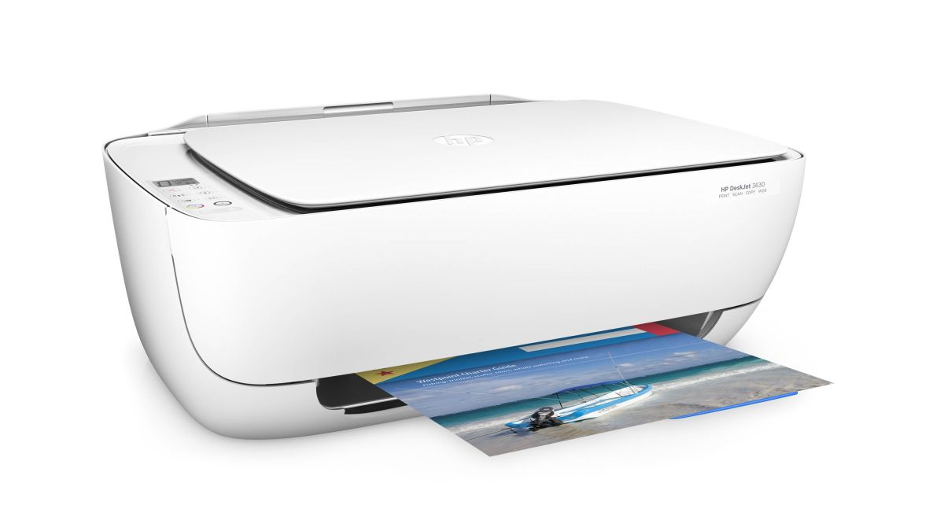
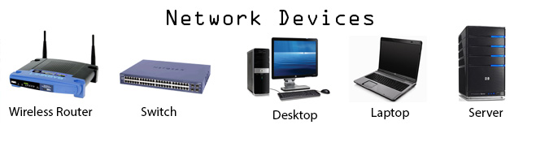
Resources
Anything available to a client on the network is considered a resource printers, data, fax devices and other network devices and information are resources.
Notes:
Anything available to a client on the network is considered a resource printers, data, fax devices and other network devices and information are resources.

Slide 9

User
Any person that uses a client to access resources on the network
Notes:
Any person that uses a client to access resources on the network

Slide 10
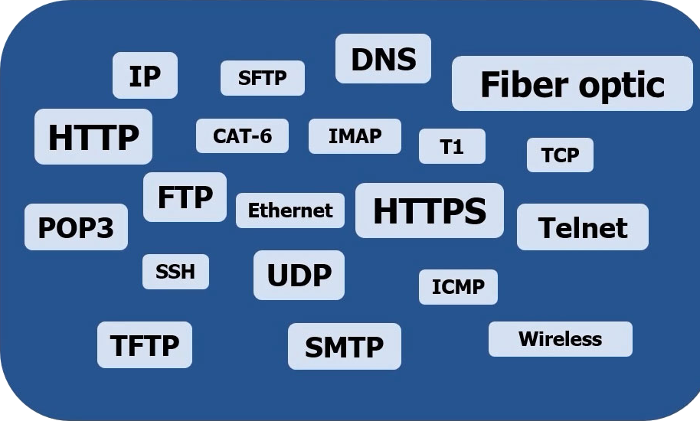
Protocols
These are written rules used for communications. They are the languages that computers use to talk to each other on a network
A network protocol is an established set of rules that determine how data is transmitted between different devices in the same network. Essentially, it allows connected devices to communicate with each other, regardless of any differences in their internal processes, structure or design.
Notes:
These are written rules used for communications. They are the languages that computers use to talk to each other on a network
A network protocol is an established set of rules that determine how data is transmitted between different devices in the same network. Essentially, it allows connected devices to communicate with each other, regardless of any differences in their internal processes, structure or design.

Slide 11
Different Types of Computer Network
Local Area Network (LAN) Metropolitan Area Network (MAN) Wide Area Network (WAN) | Storage Area Network (SAN) Virtual Area Network (VPN)

Slide 12
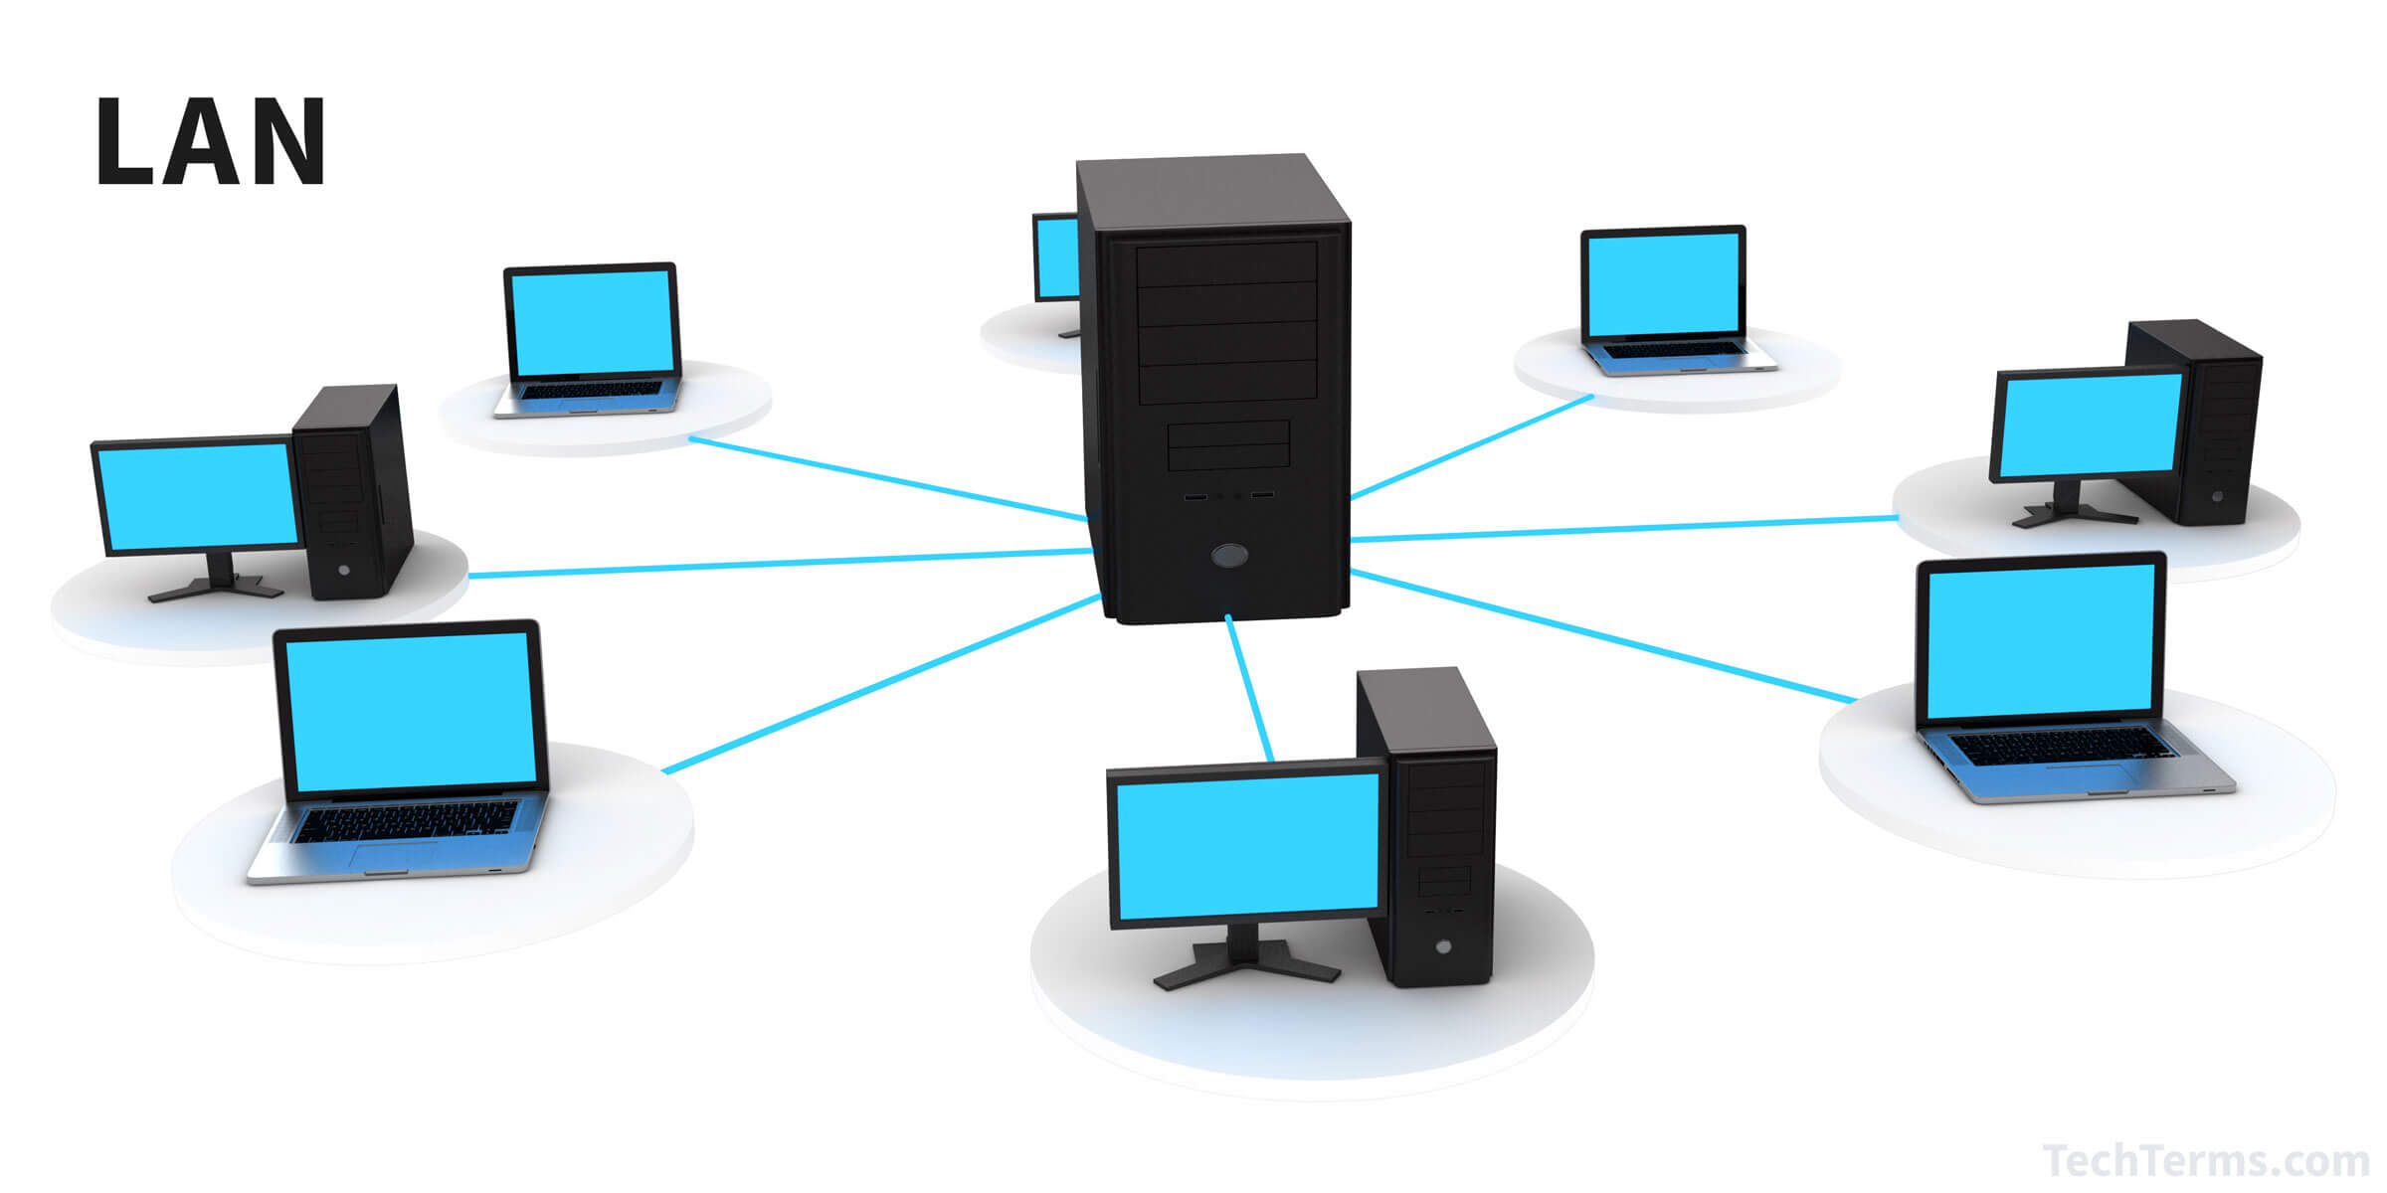
Local Area Network (LAN)
Supplies networking capability to a group of computers in close proximity to each other such as in an office building, a school, or a home. A LAN is useful for sharing resources like files, printers, games or other applications.
The function of Local Area Networks is to link computers together and provide shared access to printers, files, and other services. Local area network architecture is categorized as either peer-to-peer or client-server.
Notes:
Supplies networking capability to a group of computers in close proximity to each other such as in an office building, a school, or a home. A LAN is useful for sharing resources like files, printers, games or other applications.
The function of Local Area Networks is to link computers together and provide shared access to printers, files, and other services. Local area network architecture is categorized as either peer-to-peer or client-server.

Slide 13
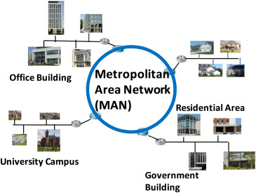
Metropolitan Area Network (MAN)
Is a computer network that usually spans a city or a large campus, A MAN usually interconnects a number of (LANs) using a high-capacity backbone technology, such as fiber-optical links.
A metropolitan area network (MAN) is a computer network that usually covers a large city or campus. MAN usually interconnects a number of local area networks (LANs) using high capacity backbone technology, such as fiber-optic links, and provides up-link services for wide area networks (or WANs) and the Internet.
Notes:
Is a computer network that usually spans a city or a large campus, A MAN usually interconnects a number of (LANs) using a high-capacity backbone technology, such as fiber-optical links.
A metropolitan area network (MAN) is a computer network that usually covers a large city or campus. MAN usually interconnects a number of local area networks (LANs) using high capacity backbone technology, such as fiber-optic links, and provides up-link services for wide area networks (or WANs) and the Internet.

Slide 14
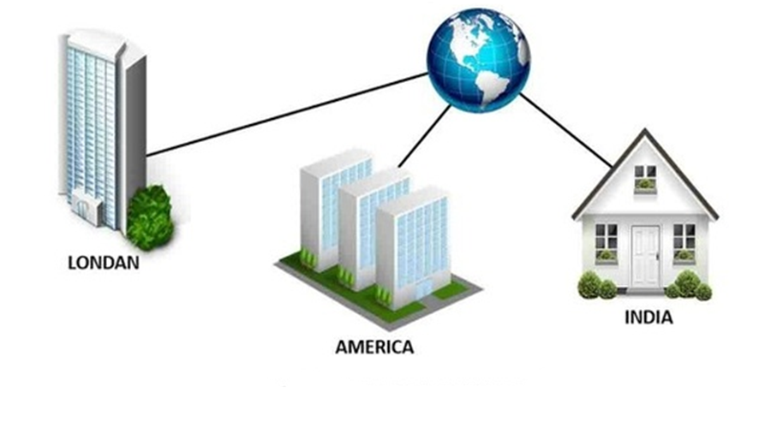
Wide Area Network (WAN)
Is a network that covers a broad area (i.e., any telecommunications network that links across metropolitan, regional, or national boundaries) using private or public network transports, Business and government entities utilize WANs to relay data among employees, clients, buyers, and suppliers from various geographical locations. In essence, this mode of telecommunication allows a business to effectively carry out its daily function regardless of location. The Internet can be considered a WAN as well, and is used by businesses, governments, organizations, and individuals for almost any purpose imaginable.
Notes:
Is a network that covers a broad area (i.e., any telecommunications network that links across metropolitan, regional, or national boundaries) using private or public network transports, Business and government entities utilize WANs to relay data among employees, clients, buyers, and suppliers from various geographical locations. In essence, this mode of telecommunication allows a business to effectively carry out its daily function regardless of location. The Internet can be considered a WAN as well, and is used by businesses, governments, organizations, and individuals for almost any purpose imaginable.

Slide 15
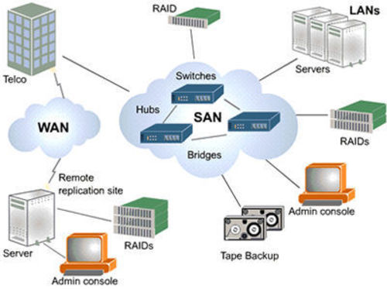
Storage Area Network (SAN)
Is a high-speed sub network of shared storage devices, A storage device is a machine that contains nothing but a disk or disks for storing data.
A Storage Area Network is a network whose main purpose is to transfer data between storage devices and servers and among storage devices.
Notes:
Is a high-speed sub network of shared storage devices, A storage device is a machine that contains nothing but a disk or disks for storing data.
A Storage Area Network is a network whose main purpose is to transfer data between storage devices and servers and among storage devices.

Slide 16
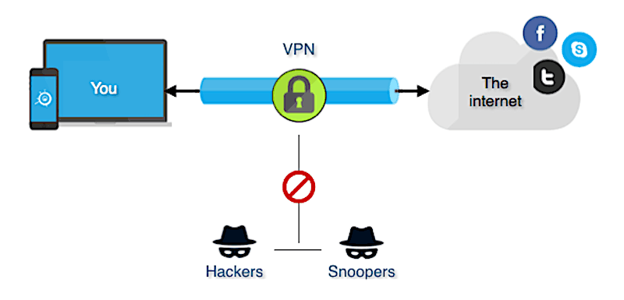
Virtual Private Network (VPN)
A virtual private network, or VPN, is an encrypted connection over the Internet from a device to a network. The encrypted connection helps ensure that sensitive data is safely transmitted. It prevents unauthorized people from eavesdropping on the traffic and allows the user to conduct work remotely. VPN technology is widely used in corporate environments.
A VPN, or Virtual Private Network, allows you to create a secure connection to another network over the Internet. VPNs can be used to access region-restricted websites, shield your browsing activity from prying eyes on public Wi-Fi, and more.
Notes:
Technology included in Windows Server 2003 helps enable cost-effective, secure remote access to private networks. VPN allows administrators to take advantage of the Internet to help provide the functionality and security of private WAN connections at a lower cost. In Windows Server 2003, VPN is enabled using the Routing and Remote Access service. VPN is part of a comprehensive network access solution that includes support for authentication and authorization services, and advanced network security technologies.
A virtual private network, or VPN, is an encrypted connection over the Internet from a device to a network. The encrypted connection helps ensure that sensitive data is safely transmitted. It prevents unauthorized people from eavesdropping on the traffic and allows the user to conduct work remotely. VPN technology is widely used in corporate environments.
A VPN, or Virtual Private Network, allows you to create a secure connection to another network over the Internet. VPNs can be used to access region-restricted websites, shield your browsing activity from prying eyes on public Wi-Fi, and more.

Slide 17
Network Topology
What is Network Topology?
- Physical and logical network layout of computer Network.
Physical – actual layout of the computer cables and other network devices.
Logical – the way in which the network appears to the devices that use it.

Slide 18
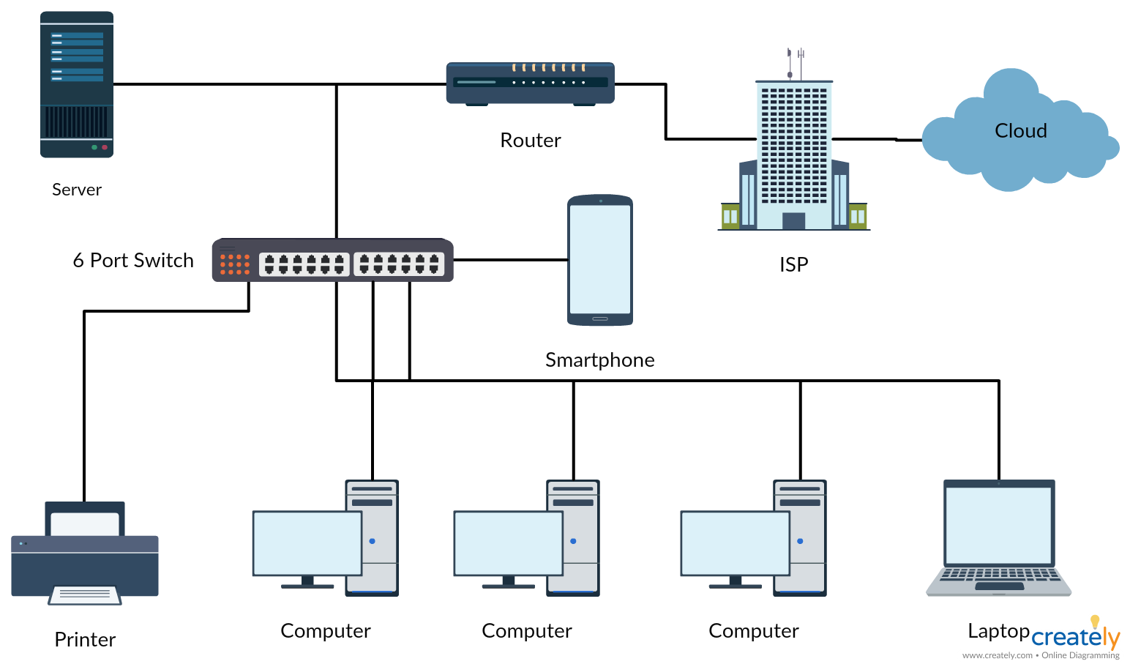
Physical Network
– actual layout of the computer cables and other network devices.
Notes:
– actual layout of the computer cables and other network devices.

Slide 19
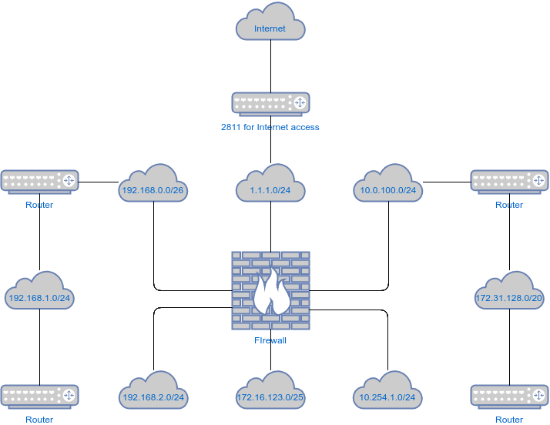
Logical Network
- the way in which the network appears to the devices that use it.
The logical Network is the definition of how signals and information travel from point to point within the network. You may see a different logical topology then the physical topology, although they could be the same.
Notes:
– the way in which the network appears to the devices that use it.
The logical Network, again, is the definition of how signals and information travel from point to point within the network. You may see a different logical topology then the physical topology, although they could be the same. For example, in a physical bus. Also, signals will use a logical line to travel from one point to the other. However, you may have a physical star like that. And still, machines are interconnected as if they were in the same cable.

Slide 20
Common Topologies
Bus Topology Ring Topology Star Topology | Mesh Topology Wireless Topology
ANGEL
GERWIN
ARCHIE
DANIEL
EMERITO
WYCO
JOSEPH
WILMER
NICK
ARMAN

Slide 21
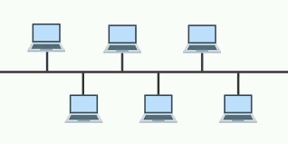
Bus Topology
Uses a trunk or backbone to which all of the computers on the network connect.
Systems connect to this backbone using T connectors or taps.
Bus topology is a method of connecting two or more computers serially, using the main cable as the center of data traffic. The connectors used in the bus topology include BNC and T connector connectors as well as terminators, while for bus transmission topologies using Coaxial cable.
Advantages
Cheap and easy to implement
Require less cable
Does not use any specialized network to troubleshoot.
Disadvantages
Network disruption when computers are added or removed
A break in the cable will prevent all systems from accessing the network.
Difficult to troubleshoot.
Notes:
Uses a trunk or backbone to which all of the computers on the network connect.
Systems connect to this backbone using T connectors or taps.
Coaxial cablings (10Base-2, 10Base5) were popular options years ago.
Bus topology is a method of connecting two or more computers serially, using the main cable as the center of data traffic. The connectors used in the bus topology include BNC and T connector connectors as well as terminators, while for bus transmission topologies using Coaxial cable.
Advantages
Cheap and easy to implement
Require less cable
Does not use any specialized network to troubleshoot.
Disadvantages
Network disruption when computers are added or removed
A break in the cable will prevent all systems from accessing the network.
Difficult to troubleshoot.

Slide 22
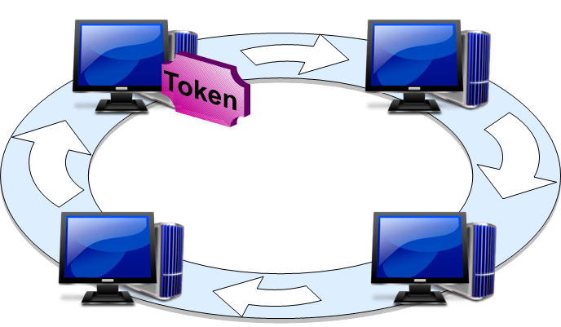
Ring Topology
A ring topology is a topology for a Local Area Network (LAN) in which every device has exactly two neighbors for communication purposes. Typically, all messages travel through a ring in the same direction. A failure in any cable or device breaks the loop and will take down the entire segment.
Notes:
A ring topology is a topology for a Local Area Network (LAN) in which every device has exactly two neighbors for communication purposes. Typically, all messages travel through a ring in the same direction. A failure in any cable or device breaks the loop and will take down the entire segment.
Logical Ring
Meaning that data travels in circular fashion from one computer to another on the network.
Typically FDDI, SONET or Token Ring technology are used to implement a ring network
Ring networks are most commonly wired in a star configuration
Token Ring
Has multi-station access unit (MSAU), equivalent to hub or switch. MSAU performs the token circulation internally.

Slide 23
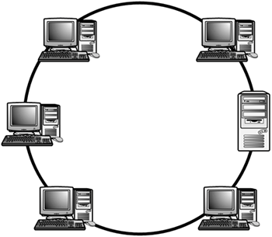
Logical Ring
Meaning that data travels in circular fashion from one computer to another on the network.
Notes:
Meaning that data travels in circular fashion from one computer to another on the network.

Slide 24
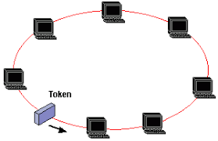
Token Ring
Token Ring uses a ring topology whereby the data is sent from one machine to the next and so on around the ring until it ends up back where it started. It also uses a token passing protocol which means that a machine can only use the network when it has control of the Token, this ensures that there are no collisions because only one machine can use the network at any given time
Ring Topology
Advantages
Cable faults are easily located, making troubleshooting easier.
Ring networks are moderately easy to install
Disadvantages
Expansion to the network can cause network disruption
A single break in the cable can disrupt the entire network.
Notes:
Token Ring uses a ring topology whereby the data is sent from one machine to the next and so on around the ring until it ends up back where it started. It also uses a token passing protocol which means that a machine can only use the network when it has control of the Token, this ensures that there are no collisions because only one machine can use the network at any given time
Ring Topology
Advantages
Cable faults are easily located, making troubleshooting easier.
Ring networks are moderately easy to install
Disadvantages
Expansion to the network can cause network disruption
A single break in the cable can disrupt the entire network.

Slide 25
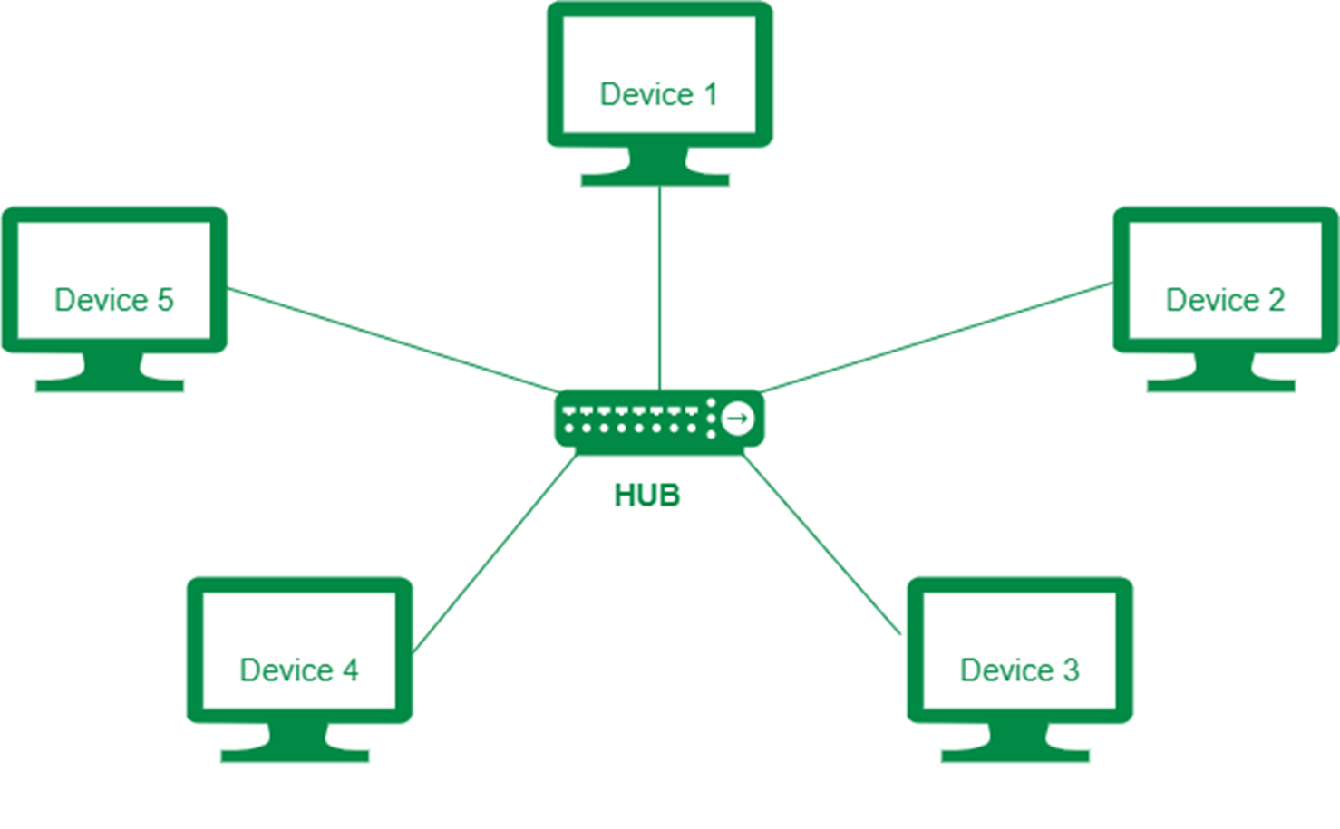
Star Topology
All computers/devices connect to a central device called hub or switch.
Each device requires a single cable point-to-point connection between the device and hub.
Most widely implemented
Hub is the single point of failure
Advantages
Easily expanded without disruption
Cable failure affects only a single user
Easy to troubleshoot and isolate the problems
Disadvantages
Requires more cable to the network
A central connecting device allows for a single point of failure
More difficult to implement
Notes:
All computers/devices connect to a central device called hub or switch.
Each device requires a single cable point-to-point connection between the device and hub.
Most widely implemented
Hub is the single point of failure
Advantages
Easily expanded without disruption
Cable failure affects only a single user
Easy to troubleshoot and isolate the problems
Disadvantages
Requires more cable to the network
A central connecting device allows for a single point of failure
More difficult to implement

Slide 26
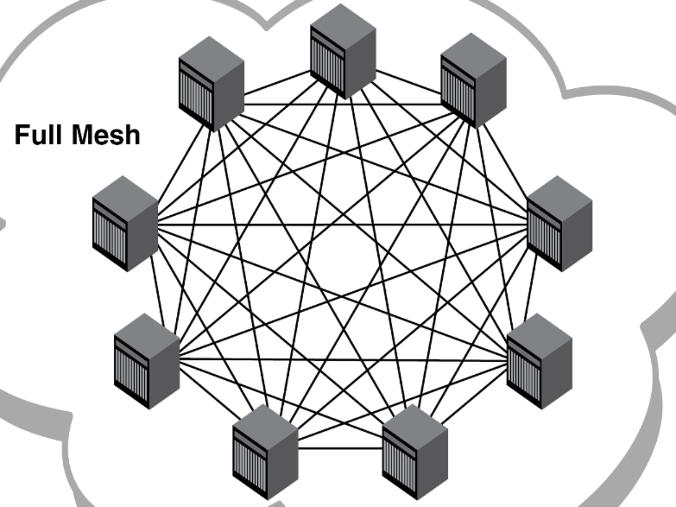
Mesh Topology
Each computer connects to every other.
High level of redundancy.
Rarely used.
Wiring is very complicated
Cabling cost is high
Troubleshooting a failed cable is tricky
A variation hybrid mesh - create point to point connection between specific network devices, often seen in WAN implementation.
Advantages
Provides redundant paths between devices
The network can be expanded without disruption to current uses
Disadvantages
Requires more cable than the other LAN topologies
Can be expanded implementation
Notes:
Each computer connects to every other.
High level of redundancy.
Rarely used.
Wiring is very complicated
Cabling cost is high
Troubleshooting a failed cable is tricky
A variation hybrid mesh - create point to point connection between specific network devices, often seen in WAN implementation.
Advantages
Provides redundant paths between devices
The network can be expanded without disruption to current uses
Disadvantages
Requires more cable than the other LAN topologies
Can be expanded implementation

Slide 27
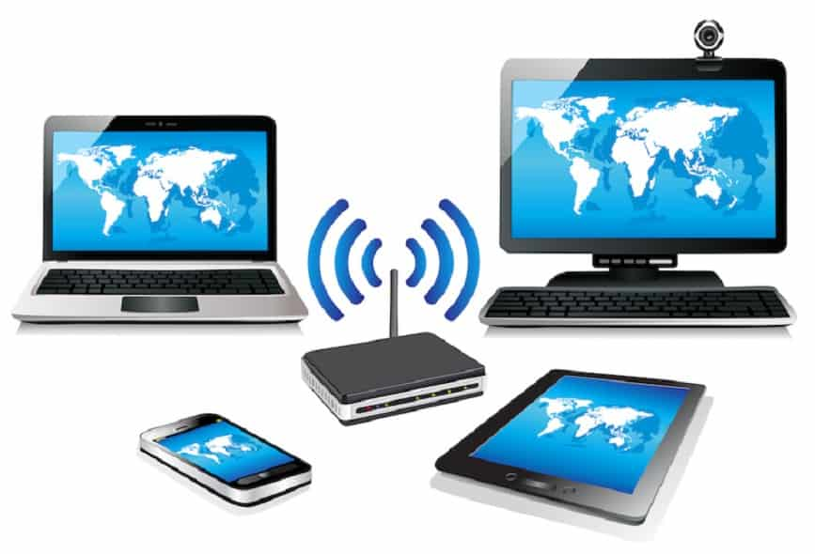
Wireless Networking
Do not require physical cabling
Particularly useful for remote access for laptop users
Eliminate cable faults and cable breaks.
Signal interference and security issue.
Advantages
Allows for wireless remote access
Network can be expanded without disruption to current users
Disadvantages
Potential security issues associated with wireless transmissions
Limited speed in comparison to other network topologies.
Notes:
Do not require physical cabling
Particularly useful for remote access for laptop users
Eliminate cable faults and cable breaks.
Signal interference and security issue.
Advantages
Allows for wireless remote access
Network can be expanded without disruption to current users
Disadvantages
Potential security issues associated with wireless transmissions
Limited speed in comparison to other network topologies.

Slide 28
NETWORK OHS & 5S PRINCIPLES
OHS Policies and Procedures
Occupational health and safety (OHS)
refers to the legislation, policies, procedures and activities that aim to protect the health, safety and welfare of all people at the workplace.
Notes:
Every worker has a right to healthy and safe work and to a work environment that enables them to live a socially and economically productive life. Safety practices should be learned early and always adhered to when working with any electrical device including personal computers and peripherals.
Here are some safety precautions to take before working with any computer devices:

Slide 29
Personal safety while working with PC’s
Before doing anything, listen to your trainer’s instruction to prevent accidents or any unwanted events that may occur on your workplace.
Be sure not to mix electronic components and water.
Avoid playing or running while inside the room.

Slide 30
Personal safety while working with PC’s
Always wear personal protective equipment (PPE) like coverall, shoes with rubber sole, antistatic wrist strap, etc.
Ask for assistance from your trainer when it comes on dealing with tools & equipment.
Applying safety measure when handling tools and equipment are necessary to avoid certain damages.
Be sure to use the tools and equipment properly to avoid accidents.

Slide 31
5S Methodology
Manufacturing companies are all familiar with the 5S methodology to organize the workspace for efficiency and effectiveness.
5S is the name of a workplace organization method that uses a list of five Japanese words:
seiri, seiton, seiso, seiketsu, and shitsuke.
Notes:
Amazingly, transliterated or translated into English, they all start with the letter S:

Slide 32
5S Methodology
sort, set, shine, standardize, sustain
(Credit goes to Hiroyuki Hirano and his overall approach to production systems)
Notes:
The obvious benefit of 5S methodology is improved productivity. This methodology can be applied to any workplace – and for our purpose we can discuss it to improve your Computer Network environment. Organizing the hardware and software used in your environment, identifying and running the items used, maintaining the equipment, and sustaining the new order through standardization, which builds understanding among employees of how they should best utilize the computer network – including hardware, software and business applications in the cloud – to be most productive at work. Let’s review.

Slide 33
1. Sort
Sorting helps you to use a red tag method that will get rid of all the different processes or items that you don’t need. Throughout the years, your organization may have acquired software and hardware that may be either used partially, or not used at all.
Notes:
Items are red tagged to eliminate what is unneeded or does not belong in your workspace. ... Items are then moved to a red tag area. This area holds the tagged items for a specific length of time, and if the item is not needed then the item can be disposed of from the red tag area.

Slide 34
2. Set
Now that you have a better understanding of what you have, and what you need – and let’s not forget some free space, you can move on to the next aspect of 5 S method: set everything in order.
Notes:
During this step you will make sure to lay out your computer network in most efficient way, and make sure that your employees have a proper workplace that allows them to be productive within your network: make sure that if new equipment, software or license is required, it is acquired. Don’t be an unintentional software pirate! Make sure that your offices are properly wired, and your necessary items such as printers, scanners, etc. at a reachable distance and can be easily accessed. So, set things in order – and then shine!

Slide 35
3. Shine
Once you have the workplace sorted and set, it’s time to put some shine on. What are you doing to make sure your network is neat and clean? The third step, shine, is crucial to the 5S methods.
Notes:
Teach your workforce the importance of maintaining and cleaning the equipment and data for a great impact on the way your business operates. Shine also helps the equipment to last longer as you aren’t neglecting it and allowing it to get cluttered or dusty. In addition to prolonging the lifespan of your equipment, keeping things right is also healthy for your employees.
When they perform their jobs better, your business is doing better. To propel your success even further, move on to the next step – standardize.

Slide 36
4. Standardize
One of the most important things you can do for your business is to standardize the equipment and processes within your computer network. New procedures, once vetted, should be properly documented and made standard.
Notes:
It will ensure that large orders and other processes would flow easily, especially if you are looking to expand your business. When you have your equipment documented, and when procedures become part of the employee manual, your organization will benefit from 8 improved operations. You can easily use standard procedures for cross-training of your employees, or bringing new hires on board. In addition, many platforms and solutions now come with options to migrate data one to another, and having a standardized setup makes things like data migrations, equipment and software updates a breeze.

Slide 37
5. Sustain
Your final step, sustain, is the hardest – not falling back into old habits is not easy. It is even more difficult if you don’t have a full-time IT staff on board to perform tech support and maintenance.
NHEIL
JONAS
MARK
PAUL
Notes:
Left unmonitored, your data, your network and computer equipment and devices may get compromised and bring you to a gradual decline back to the old ways. It may affect your business directly by having your business data and environment vulnerable. It turns, it will leave employees idle and impacting your ability to do business, costing you evens more through the loss of productivity, revenue, or reputation.

Slide 38
NETWORK TOOLS, EQUIPMENT, MATERIALS & TESTING DEVICES
Network Tools
- This are the tools needed for Computer Networking Set-up
Network Equipment
network equipment or computer networking devices, are electronic devices which are required for communication and interaction between devices on a computer network.

Slide 39
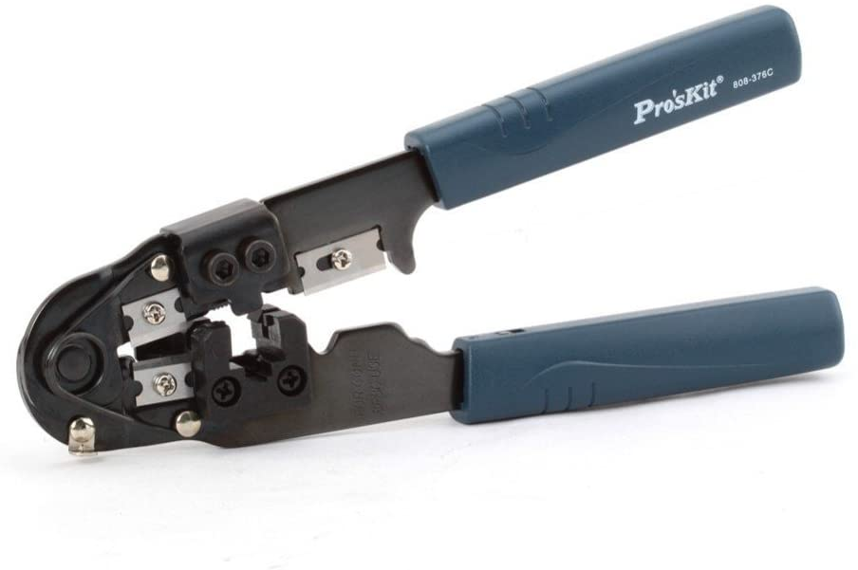
Network Tools
Crimping tool
- A crimping tool is a tool designed to crimp or connect a connector to the end of a cable. For example, network cables and phone cables are created using a crimping tool to connect the RJ-45 and RJ-11 connectors to the end of the cable.
Notes:
In the example picture below, this crimper is capable of crimping a RJ-11 (6-Pin) and RJ-45 (8-Pin) connectors and also includes a wire cutter near the handles that can be used to cut phone or CAT5 cable.

Slide 40

Network Tools
Wire stripper
- A tool designed to remove the protective covering off of a cable to expose the inner wires. Because different wires come in different shapes, there are dozens of different wire strippers available.
Notes:
The picture shows an example of a wire stripper, which strips a cable by placing the cable in-between the blade and one of the ridges and then spun around the cable until the jacket can be pulled off.

Slide 41

Network Tools
Electric Hand Drill with Drill bit
- Is a tool fitted with a cutting tool attachment or driving tool attachment, usually a drill bit or driver bit, used for boring holes in various materials or fastening various materials together with the use of fasteners.
Notes:
The attachment is gripped by a chuck at one end of the drill and rotated while pressed against the target material. The tip, and sometimes edges, of the cutting tool does the work of cutting into the target material. This may be slicing off thin shavings (twist drills or auger bits), grinding off small particles (oil drilling), crushing and removing pieces of the work piece (SDS masonry drill), countersinking, counter boring, or other operations. Drills are commonly used in woodworking, metalworking, construction and do-ityourself projects. Specially designed drills are also used in medicine, space missions and other applications. Drills are available with a wide variety of performance characteristics, such as power and capacity.

Slide 42
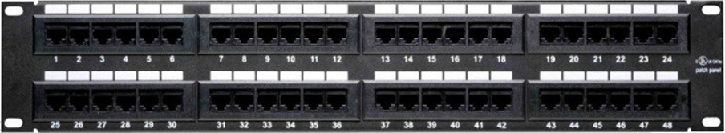
Network Equipment
Patch panel
- A patch panel, patch bay, patch field or jack field is a device or unit featuring a number of jacks, usually of the same or similar type, for the use of connecting and routing circuits for monitoring, interconnecting, and testing circuits in a convenient, flexible manner.

Slide 43
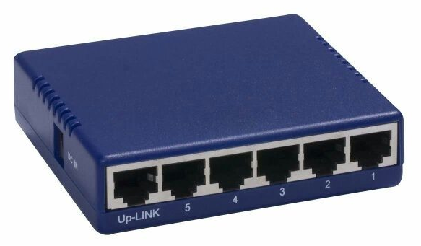
Network Equipment
Network Hub
- When referring to a network, a hub is the most basic networking device that connects multiple computers or other network devices together.
Notes:
Unlike a network switch or router, a network hub has no routing tables or intelligence on where to send information and broadcasts all network data across each connection. Most hubs can detect basic network errors such as collisions, but having all information broadcast to multiple ports can be a security risk and cause bottlenecks. In the past network hubs were popular because they were much cheaper than a switch and router, but today most switches do not cost much more than a hub and are a much better solution for any network.
In general, a hub refers to a hardware device that enables multiple devices or connections to be connected to a computer. Another example besides the one given above is a USB hub, which allows dozens of to be connected to one computer, even though that computer may only have a few USB connections. The picture is an example of a USB hub.

Slide 44
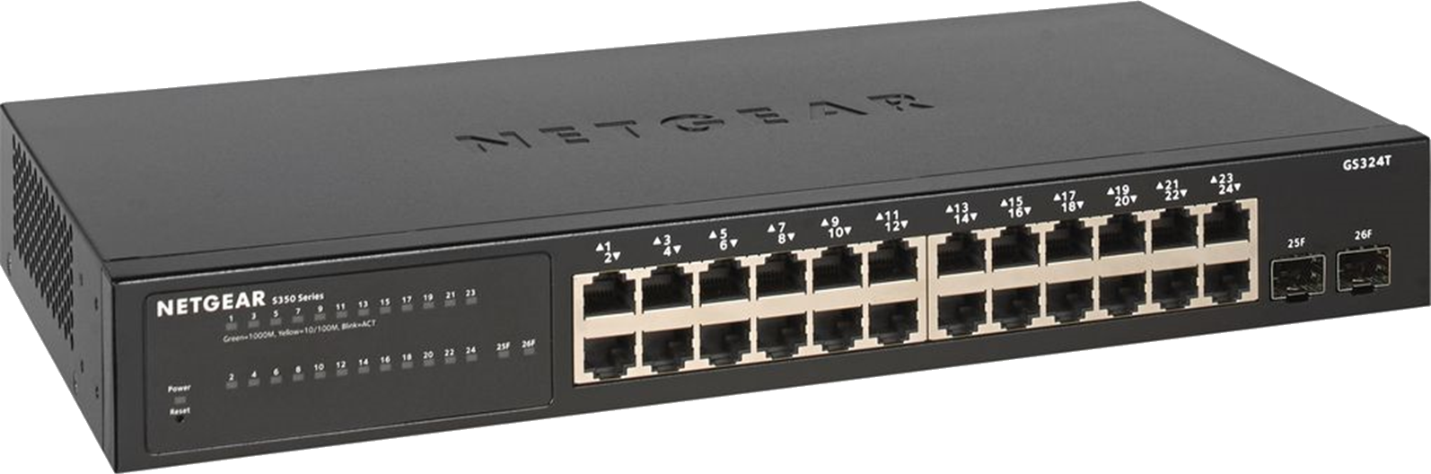
Network Equipment
Network Switch
- A network switch (also called switching hub, bridging hub, officially MAC Bridge) is a computer networking device that connects devices together on a computer network, by using packet switching to receive, process and forward data to the destination device.
Notes:
Unlike less advanced network hubs, a network switch forwards data only to one or multiple devices that need to receive it, rather than broadcasting the same data out of each of its ports.

Slide 45
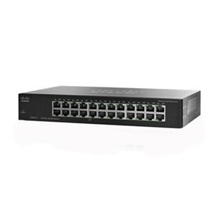
Network Equipment
Managed Switch
- Give you more control over your LAN traffic and offer advanced features to control that traffic.
Notes:
An unmanaged switch simply allows Ethernet devices to communicate with one another, such as a PC or network printer, and those are typically what we call “plug and play.”

Slide 46
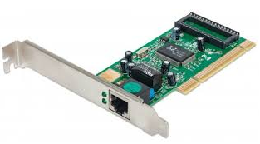
Network Equipment
Network Controller/Network Interface Card
- A network interface controller (NIC, also known as a network interface card, network adapter, LAN adapter or physical network interface and by similar terms) is a computer hardware component that connects a computer to a computer network.
Notes:
Early network interface controllers were commonly implemented on expansion cards that plugged into a computer bus. The low cost and ubiquity of the Ethernet standard means that most newer computers have a network interface built into the motherboard.
Modern network interface controllers offer advanced features such as interrupt and DMA interfaces to the host processors, support for multiple receive and transmit queues, partitioning into multiple logical interfaces, and on-controller network traffic processing such as the TCP offload engine.

Slide 47
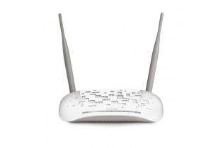
Network Equipment
Wireless Router
- A wireless router is a device that performs the functions of a router and also includes the functions of a wireless access point. It is used to provide access to the Internet or a private computer network.
Notes:
It can function in a wired LAN (local area network), in a wireless-only LAN (WLAN), or in a mixed wired/wireless network, depending on the manufacturer and model.

Slide 48
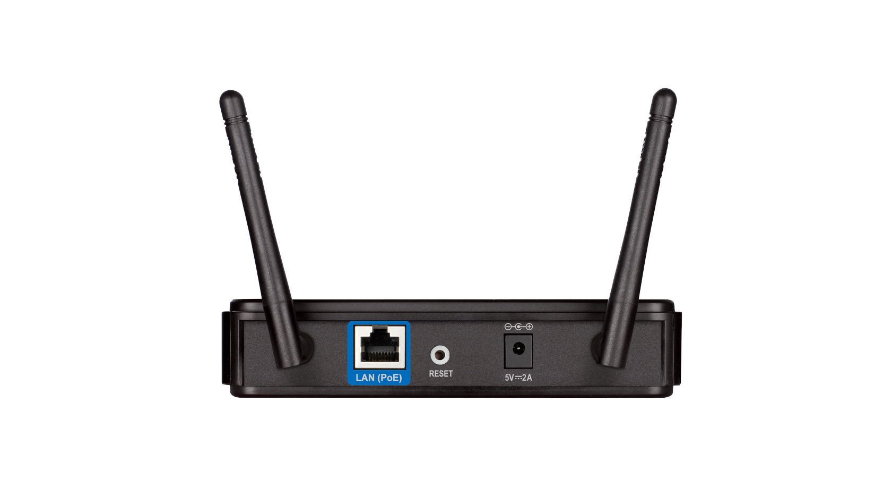
Network Equipment
Wireless Access Point
- In computer networking, a wireless access point(AP) is a device that allows wireless devices to connect to a wired network using Wi-Fi, or related standards.
Notes:
The AP usually connects to a router (via a wired network) as a standalone device, but it can also be an integral component of the router itself.

Slide 49
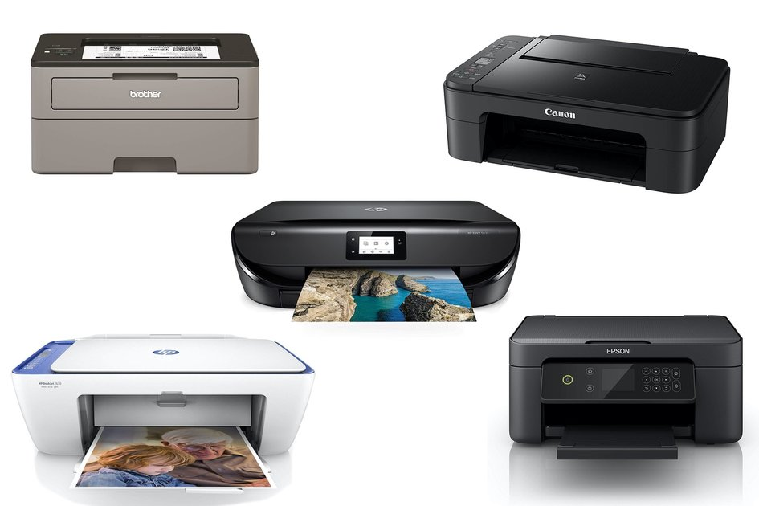
Network Equipment
Printer
- In computing, a printer is a peripheral which makes a persistent human readable representation of graphics or text on paper or similar physical media.
Notes:
The two most common printer mechanisms are black and white laser printers used for common documents, and color inkjet printers which can produce high quality photograph quality output.
Types of Printer
Laser Printers.
Solid Ink Printers.
LED Printers.
Business Inkjet Printers.
Home Inkjet Printers.
Multifunction Printers.
Dot Matrix Printers.
3D Printers.

Slide 50
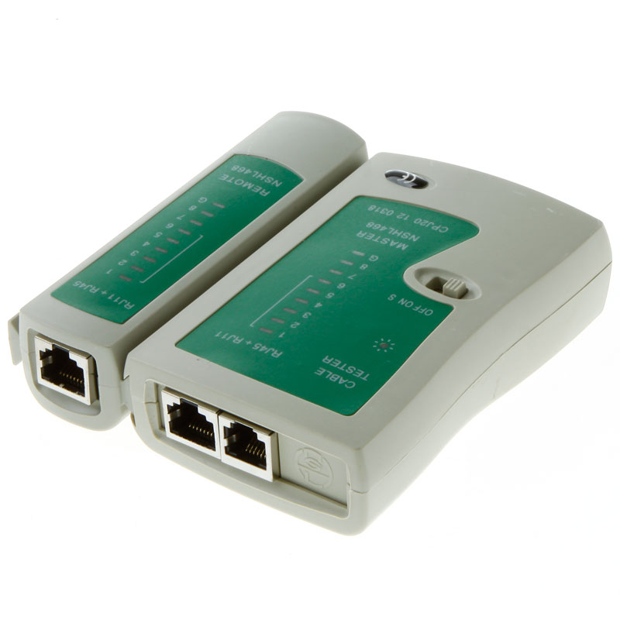
Network Equipment
Cable Tester/Network Tester
- A cable tester is a device that is used to test the strength and connectivity of a particular type of cable or other wired assemblies.
Notes:
There are a number of different types of cable testers, each able to test a specific type of cable or wire (some may be able to test different types of cables or wires).

Slide 51
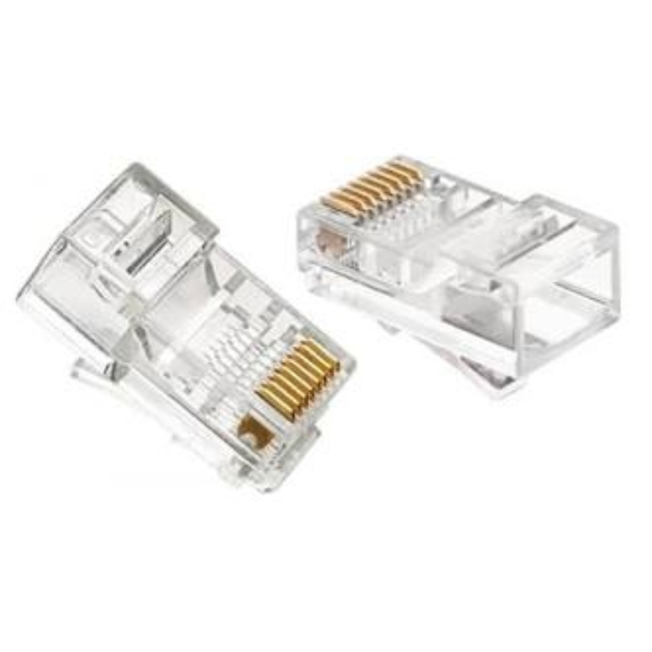
Network Materials
RJ 45
- Short for Registered Jack-45, an eight-wire connector used commonly to connect computers onto local-area networks (LAN), especially Ethernets.

Slide 52
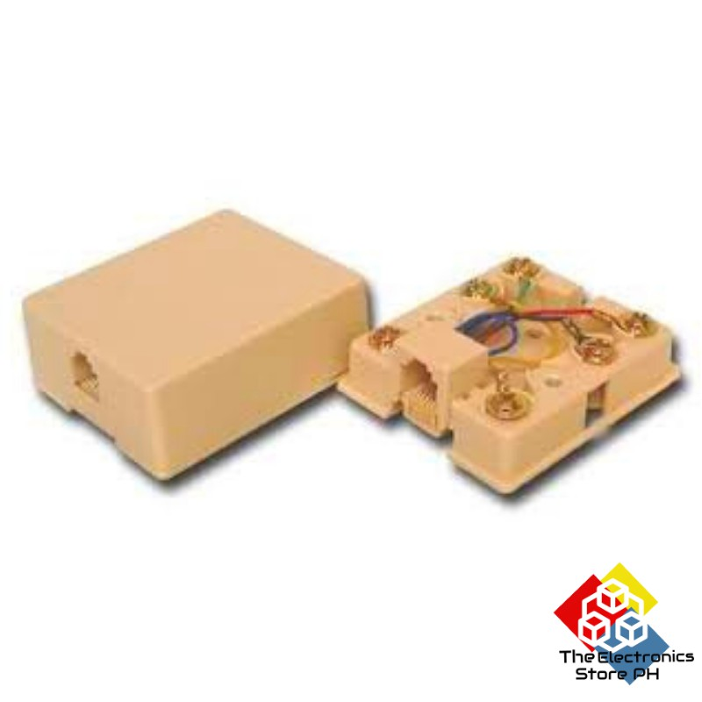
Network Materials
Modular Box
- Use to in a large building, usually place on the wall to connect telephone lines or network cable easily.

Slide 53
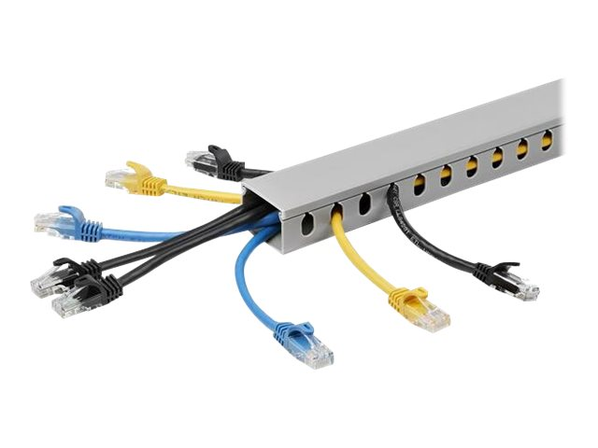
Network Materials
Raceway
- A raceway (sometimes referred to as a raceway system) is an enclosed conduit that forms a physical pathway for electrical wiring. Raceways protect wires and cables from heat, humidity, corrosion, water intrusion and general physical threats.

Slide 54
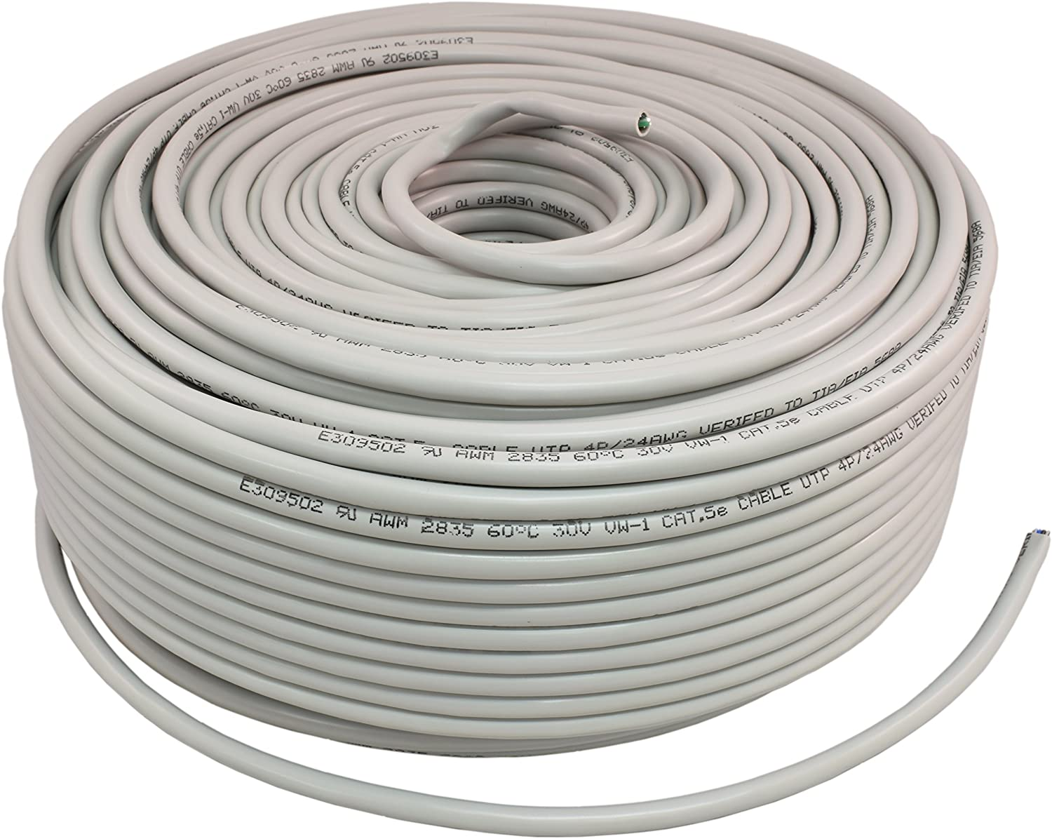
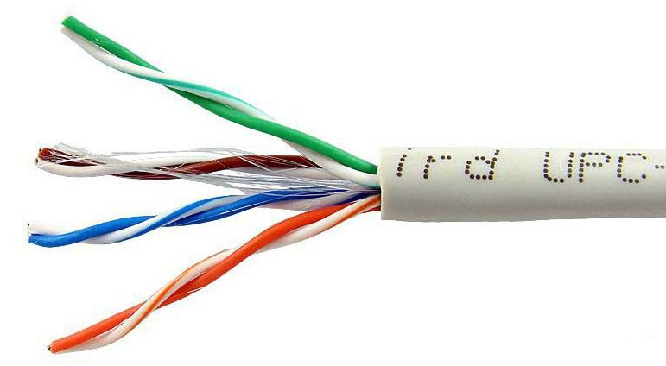
Network Materials
UTP Cable
- Unshielded Twisted Pair cable is most certainly by far the most popular cable around the world. UTP cable is used not only for networking but also for the traditional telephone.

Slide 55
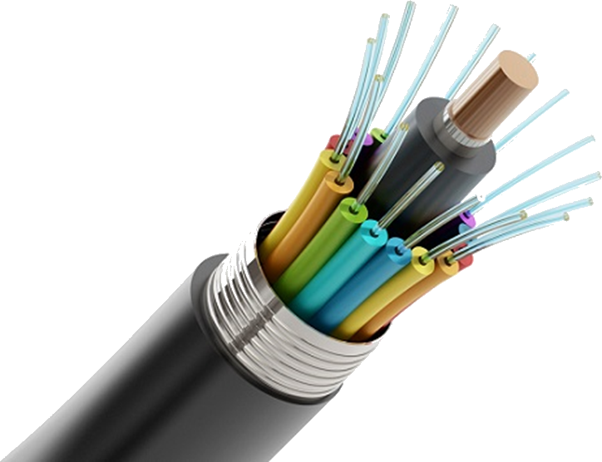
Network Materials
Fiber Optic Cable
- An optical fiber cable is a cable containing one or more optical fibers that are used to carry light. The optical fiber elements are typically individually coated with plastic layers and contained in a protective tube suitable for the environment where the cable will be deployed.

Slide 56
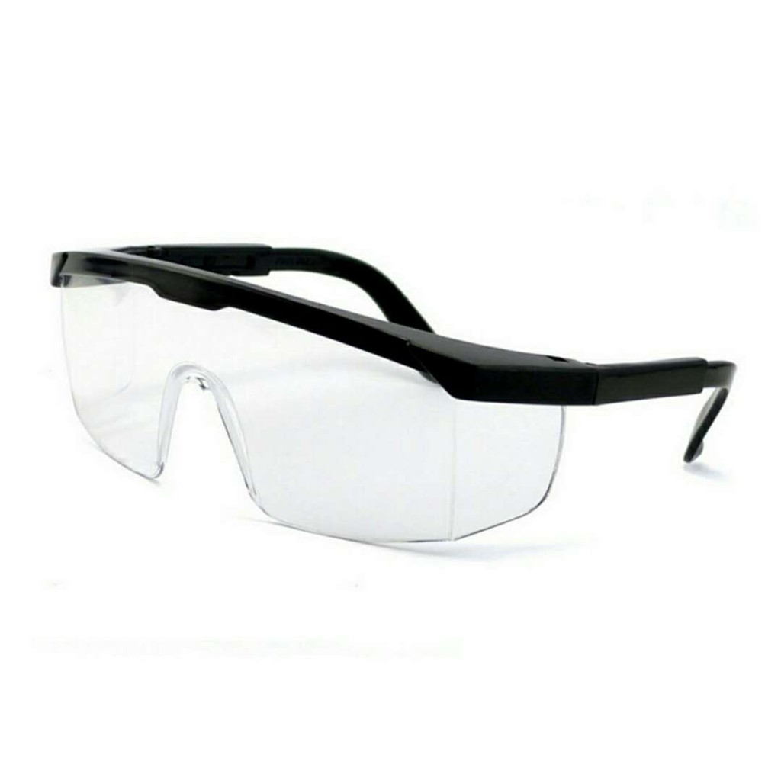
Network Personal Protective Equipment
Protective eyewear
- is protective gear for the eyes, which comes in many types depending upon the threat that is to be reduced. The threats can be particles, light, wind blast, heat, sea spray or some type of ball or puck used in sports.

Slide 57
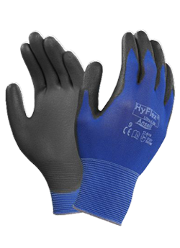
Network Personal Protective Equipment
Gloves
- A glove (Middle English from Old English glof) is a garment covering the whole hand. Gloves have separate sheaths or openings for each finger and the thumb; if there is an opening but no covering sheath for each finger they are called "fingerless gloves".
Notes:
Fingerless gloves have one large opening rather than individual openings for each finger are sometimes called gauntlets. Gloves which cover the entire hand or fist but do not have separate finger openings or sheaths are called mittens. Mittens are warmer than gloves made of the same material because fingers maintain their warmth better when they are in contact with each other. Reduced surface area reduces heat loss.

Slide 58

Network Personal Protective Equipment
Working clothes
- is clothing worn for work, especially work that involves manual labor. Often those employed within trade industries elect to be outfitted in workwear because it is built to provide durability and safety.

Slide 59
NETWORK CABLE INSTALLATION AND TESTING
What is Network Cables?
- Networking cables are used to connect one network device to other network devices or to connect two or more computers to share printer, scanner etc.
Notes:
Different types of network cables like Coaxial cable, Optical fiber cable, Twisted Pair cables are used depending on the network's topology, protocol and size. The devices can be separated by a few meters (e.g. via Ethernet) or nearly unlimited distances (e.g. via the interconnections of the Internet).

Slide 60
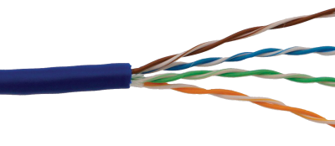
Network Cables
Unshielded Twisted Pair
- Unshielded Twisted Pair cable is most certainly by far the most popular cable around the world. UTP cable is used not only for networking but also for the traditional telephone.

Slide 61
UTP Cable Categories
CAT1 - Data rate up to 1Mbps - Traditional Telephone & ISDN – Modem CAT2 - Data rate up to 4Mbps - Token Ring CAT3 - Data rate up to 10Mbps - Token Ring & 10Base-T CAT4 - Data rate up to 16Mbps - Token Ring | CAT5 - Data rate up to 100Mbps - Ethernet (10Mbps) - Fast Ethernet (100Mbps) & Token Ring (16Mbps) CAT5e - Data rate up to 1000Mbps - Gigabit Ethernet CAT6 - Data rate up to 1000Mbps - Gigabit Ethernet

Slide 62
Ethernet Cable Standard Color Coding
TIA/EIA 568-A standard which was ratified in 1995, was replaced by the TIA/EIA 568-B standard in 2002 and has been updated since. Both standards define the T-568A and T-568B pin-outs for using Unshielded Twisted Pair cable and RJ-45 connectors for Ethernet connectivity.
Notes:
the TIA (Telecommunications Industry Association) and the EIA (Electronic Industries Association) began developing methods for cabling buildings, with the intent of developing a uniform wiring system that would support multivendor products and environments.
Both the T-568A and the T-568B standard Straight-Through cables are used most often as patch cords for your Ethernet connections. If you require a cable to connect two Ethernet devices directly together without a hub or when you connect two hubs together, you will need to use a Crossover cable instead.
A good way of remembering how to wire a Crossover Ethernet cable is to wire one end using the T-568A standard and the other end using the T-568B standard. Another way of remembering the color coding is to simply switch the Green set of wires in place with the Orange set of wires. Specifically, switch the solid Green (G) with the solid Orange, and switch the green/white with the orange/white.

Slide 63
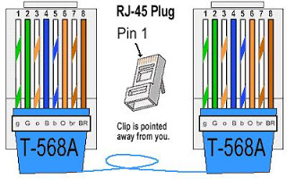
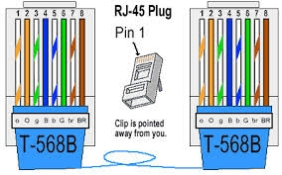
Straight-Through Ethernet Cable

Slide 64
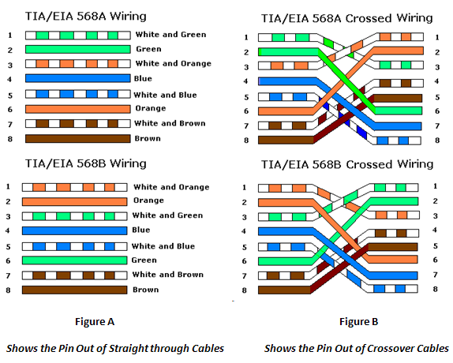
Crossover Cable Wiring

Slide 65
Ethernet Cable Tips
A straight-thru cable has identical ends.
A crossover cable has different ends.
A straight-thru is used as a patch cord in Ethernet connections.
A crossover is used to connect two Ethernet devices without a hub or for connecting two hubs.
A crossover has one end with the Orange set of wires switched with the Green set.

Slide 66
Ethernet Cable Tips
Odd numbered pins are always striped, even numbered pins are always solid colored.
Looking at the RJ-45 with the clip facing away from you, Brown is always on the right, and pin 1 is on the left.
No more than 1/2″ of the Ethernet cable should be untwisted otherwise it will be susceptible to crosstalk.
Do not deform, do not bend, do not stretch, do not staple, do not run p

Slide 67
How to wire your room with Cat5e or Cat6 Ethernet Cable
Although wireless is simpler for a lot of people, due to multimedia sharing, bandwidth on a home network, and paranoia about wireless security, you may want to use a hard wired solution for home networking. Having a wired network at home allows you to have a private, high-speed network for internet access, file sharing, media streaming, online gaming, IP security cameras, and much more.

Slide 68
Step 1: Initial Considerations and Planning
There are certain design considerations that need to be addressed based on your needs.
Which room(s) do I want wired?
How many ports do I want in each location?
What is a good location for distribution?
What path should the cables take?
What network speed do I need?

Slide 69
Step 2: Required Tools, Equipment and Materials Tools
Tools
Crimping Tool
Electric Hand Drill
Wire Stripper
Equipment
Patch panel
Network Switch/Hub
Wireless Router
Wireless Access point
Manage Switch

Slide 70
Step 2: Required Tools, Equipment and Materials Tools
Materials
Cat5e or Cat6 UTP
Cat5e or Cat6 UTP Cable Crimp (Straight-through & Crossover)
Raceways
Modular Box
Label maker (optional).

Slide 71
Step 3: Measure and Run the Cables
There are a number of ways to do this. You can estimate, measure from floor plans, run one, etc.

Slide 72
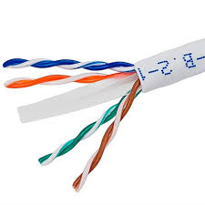
Step 4: Connect the Wires to the Patch Panel
Strip the sheath
Remove the cable sheath 2.54 cm (1 inch) from the end of the cable.

Slide 73
Step 4: Connect the Wires to the Patch Panel
Position wires in data jack
Position wires in the proper channels on the RJ-45 jack maintaining the twists as close to the jack as possible. The diagram that follows shows an example of how to place the wires with one type of jack.

Slide 74
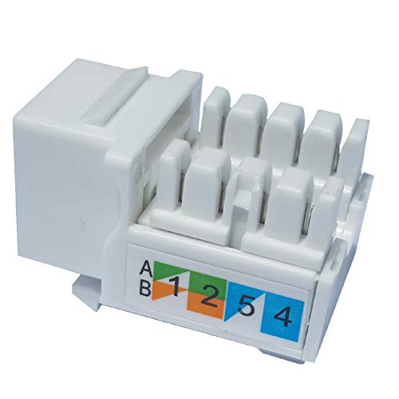
Step 4: Connect the Wires to the Patch Panel
Most jacks have the channels color-coded to indicate where the wires go. The following photo of the jack shows one model. Jacks are typically stamped to indicate whether they are T568A or T568B.
Notes:
Using modular box

Slide 75
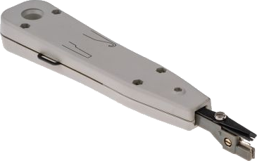
Step 4: Connect the Wires to the Patch Panel
Punch down the data jack
Use the punch tool to push conductors into the channels. Make sure to position the cutting side of the punch tool so that it faces the outside of the jack. If this is not done, it will cut the wire being punched. Try tilting the handle of the punch tool a little to the outside, so it will cut better.

Slide 76
Step 4: Connect the Wires to the Patch Panel
Punch down the data jack
If any wire remains attached after using the punch tool, simply twist the ends gently to remove them. Then place the clips on the jack, and tighten them. Make sure that no more than 1.27 cm (one half inch) of untwisted wire is between the end of the cable jacket and the channels on the jack. Attach the faceplate.
Snap the jack into the faceplate by pushing it from the back side. Make sure when this is done, that the jack is right-side up so the clip faces down when the wall plate is mounted.

Slide 77
Step 4: Connect the Wires to the Patch Panel
Punch down the data jack
Use the screws to attach the faceplate to either the box or to the bracket. If there is a surface mounted box, keep in mind that it might hold 30-60 cm (1-2 feet) of excess cable. Then it will be necessary to either slide the cable through the tie-wraps, or pull back the raceway that covers it, in order to push the excess cable back into the wall. If there is a flush-mounted jack, all that is needed is to push the excess cable back into the wall.

Slide 78
Step 4: Connect the Wires to the Patch Panel
Punch down the patch panel
On the opposite end of the cabling, remove the jacket 2.54 cm (1 inch) from the cable.
Lay the wires down in the patch panel so that the colors of the wires correspond exactly to the colors indicated on the pin locations in the same manner as the data jack was punched down.
Keep the sheath within .64 cm (¼ inch) of where the wires begin branching out to their pin locations.

Slide 79
Step 4: Connect the Wires to the Patch Panel
Punch down the patch panel
Do not untwist the wires more than necessary to lay them down at the pin locations. A good way to keep from untwisting too much is to hold down the wires next to the patch panel with one finger while using the other hand to pull apart each end as you lay it across the connector.

Slide 80
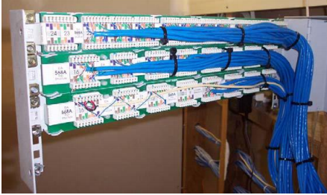
Step 4: Connect the Wires to the Patch Panel
Punch down the patch panel
The following figure shows a large punch down patch panel with carefully routed cabling.

Slide 81
Step 5: Test the data jack and patch panel terminations
Obtain two straight-through Ethernet patch cables and verify they both function properly using a simple cable tester.
Connect one end of one of the straight-through Ethernet patch cables to the data jack outlet and one end of the other straight-through cable to the jack at the patch panel.

Slide 82

Step 5: Test the data jack and patch panel terminations
Insert the opposite ends of the two cables into a simple cable tester and check for continuity from end to end through both patch cables, the data jack, and the patch panel. Did the cable run test good from end to end?

Slide 83

Step 6: Connect the wires to the modular box
Make sure the stripper is adjusted properly on a scrap piece of cable. The Stripper should be adjusted to only score the jacket to make removing it easier and not nick the twisted pairs.

Slide 84
Step 6: Connect the wires to the modular box
Straighten the pairs out completely and lay them over the top of the keystone jack noting the color pattern for the 568b wiring. Note: Each keystone jack is slightly different in how they are labeled and how the colors are arranged. The 568B standard is most commonly used and ends of the cable must have the same standards to communicate. We have the 3 most common keystone jack styles pictured here.

Slide 85
Step 6: Connect the wires to the modular box
The first jack pictured has the 2 standard pairs on the right, and the 2 variable pairs on the left. The A standard is the center column and the B standard is on the left. Both A and B standard applies to the right side of the jack. The solid color box with the lower right corner missing represents the solid color wire with the white stripe. The white box with the colored tip represents the white wire with the colored stripe.

Slide 86
Step 6: Connect the wires to the modular box
The second jack pictured here has both A and B 22 standards on both sides of the jack, with the color code running down the center. The solid color rectangle represents the solid color wire with the white stripe, wile the half white half color rectangle represents the white wire with the colored stripe.

Slide 87
Step 6: Connect the wires to the modular box
The third jack pictured here has the A and B standard codes labeled on the outside of the jack. With the A standard on top and the B standard on the bottom. The solid box represents the solid wire with the white stripe Wile the box with the white diagonal stripe going through the middle, represents the white wire with the colored stripe.

Slide 88

Step 6: Connect the wires to the modular box
Keeping the pairs as twisted as possible press the wire into the correct groove with your thumbs. If you completely straighten the wires to run them through the jack you will risk cross talk between the pairs.

Slide 89
Step 6: Connect the wires to the modular box
Using a punch down tool punch the wires down into the blades built into the keystone jack. The blades in the jack are designed to work with solid cable, and may not work with stranded cable. Make sure the blade (as noted in the picture) is facing the outside of the keystone jack. If you reverse it you will cut the wires inside the keystone jack rendering them useless.

Slide 90


Step 6: Connect the wires to the modular box
Notes:
The punch down tool should cut off the remaining pieces of the wire on the outside, but sometimes you may need to punch them down a 2nd time and wiggle the wire to it breaks clean off. Once this is done you can install the dust covers if your keystone jack comes with them. This keystone jack did not have the covers. The covers should never be used to do the job of the punch down tool.

Slide 91
Step 7: Connect to the Internet
Connect Network Switch/Hub to the patch panel using cross-over cable base on the network topology.
Connect the Wireless Router to the Network hub & to the Modem using cross-over cable base on the network topology.

Slide 92

Step 7: Connect to the Internet
Connect your pc on the modular box using straight-through cable.

Slide 93
CONFIGURE COMPUTER NETWORK
What is IP Address?
An Internet Protocol address (IP address) in layman’s terms is basically the address given to your computer when it’s connected to a network. Technically speaking, an IP address is a 32-bit number that signifies the address of both the sender and receiver of packets on a network.
Notes:
Let’s take an example: suppose you want to send an email to your friend. Though your email may be broken down into millions of data packets before it’s transmitted, right now for simplicity’s sake consider it a single information packet. The IP addresses are embedded on each packet that is transmitted over the network and are used to identify the machine.

Slide 94

CONFIGURE COMPUTER NETWORK
Notes:
Note: It’s totally possible for your computer to have two IP addresses at the same time. One may be for the Internet and another one for the local area network.
These IP addresses are further divided into two main types: Static and Dynamic IP address. Let’s have a good look at both for better understanding.

Slide 95
CONFIGURE COMPUTER NETWORK
Static IP Address
- As the name speaks, the static IP addresses are those types of IP address that never change once they are assigned to a device on a network. No doubt this type of addressing is cost effective but could have a high security risk.
Notes:
Static IP addresses are mostly used by web, email and gaming servers who don’t care much about hiding their locations.

Slide 96
CONFIGURE COMPUTER NETWORK
Dynamic IP Address
- On the other hand, a Dynamic IP address changes each time the device logs in to a network. This kind of IP address is very tough to trace and are thus used by companies and business firms.
Notes:
You must be thinking as to who or what allocates this Dynamic IP address every time the device logs in. Well, these IP address are assigned using DHCP (Dynamic Host Configuration Protocol). Talking about DHCP in detail is beyond the scope of this article and we will take it up in a future post.

Slide 97
CONFIGURE COMPUTER NETWORK
Which is better, Static or Dynamic?
- You are probably wondering which type of IP addressing is better, Static or Dynamic? Static IP addresses, as I already mentioned above, are used in places where security is not a big concern like web servers, FTP and dedicate VOIP services. Dynamic IP addressing, on the other hand are used when you browse through the Internet, receive mails, download files, etc.

Slide 98
CONFIGURE COMPUTER NETWORK
How to Configure a Static IP Address in Windows 7
- Sometimes in order to gain connectivity in certain networks where a DHCP server is not running, the configuration of a static IP address is required.
Notes:
The steps required to setup up a static IP address are rather straightforward, but the process is a bit different from Windows Vista and XP.

Slide 99

CONFIGURE COMPUTER NETWORK
Let’s go through the steps now and configure a static IPv4 address in Windows 7.

Slide 100

CONFIGURE COMPUTER NETWORK
Static IPv4 Configuration in Windows 7
The first thing that must be done is to gain access to the Network and Sharing Center in Windows 7. This can be done in one of two ways; the first way to access it is via the control panel.
Notes:
Select the Windows 7 or on the bottom left-hand corner and select the control panel option as shown in the image:

Slide 101

CONFIGURE COMPUTER NETWORK
There are several views which are available for the control panel; by default the category view is used. When using the category view the option that you need to select is called View network status and Tasks, as highlighted below.
Notes:
This will bring you to the Network and Sharing Center.

Slide 102
CONFIGURE COMPUTER NETWORK
The second way to gain access to the Network and Sharing Center is to utilize the network icon which is displayed in the system tray when a network interface has been enabled.

Slide 103

CONFIGURE COMPUTER NETWORK
When this icon is right-clicked the option to open the Network and Sharing Center is given as shown below:
Notes:
Once the Network and Sharing Center is open there is an option which allows the change of adapter settings which is shown in the upper left hand corner of the window. This is shown highlighted in the following figure (click on the image to enlarge):

Slide 104

CONFIGURE COMPUTER NETWORK
Notes:
Then click Change adapter settings
Once in the Network Connections window, an interface must be selected which is going to be configured with the static IP address. In the following example, both a wired and wireless interface is shown as examples.

Slide 105

CONFIGURE COMPUTER NETWORK
For the purposes of this article the wired interface will be used as the interface being given a static IP Address.
Notes:
Once the properties option is selected the interface properties windows will be displayed. This screen gives the option to configure a number of different network parameters.

Slide 106

CONFIGURE COMPUTER NETWORK
Since we want to change the interface IPv4 IP address this option must be selected from the window. Once this option is selected the properties button will be enabled; press the properties button.
Notes:
Once the properties button is pressed the IPv4 properties window is displayed which shows that the interface is currently configured to obtain both its IP address and its DNS server information automatically.

Slide 107

CONFIGURE COMPUTER NETWORK
In order to change to a static IP address the option to Use the following IP address must be selected; once this is done the option to enter the IP address parameters is enabled and the Use the following DNS server addresses option is selected.
Notes:
For the purpose of this article the IP address 192.168.1.100 is used with a subnet mask of 255.255.255.0 and a default gateway of 192.168.1.1. The DNS server which will be configured is 4.2.2.2.

Slide 108

CONFIGURE COMPUTER NETWORK
These options are shown in their correct locations in the following figure:
Notes:
Once these options have been entered on the screen simply press Ok on both property screens and the configuration of a static IP is complete.
The knowledge of static IP configuration is vital in modern organizational environments as many do not completely utilize automatic IP assignment; it is also vital knowledge when trying to troubleshoot IPv4.

Slide 109
HOMEGROUP Configuration in Windows 7
A new option which was introduced with Windows 7 is Home Group. Home Group allows Windows 7 machines to be linked in an easier way which makes the sharing of resources between machines much simpler to setup. Each machine must become a member of a Home Group in order to utilize this functionality.
Notes:
The first thing that must be done on the first computer used is the creation of a Home Group. This is done through the Choose Home Group and Sharing Options in the Network and Sharing Center window.

Slide 110

HOMEGROUP Configuration in Windows 7
Notes:
Once this option is selected, the Home Group window is displayed. The first computer to be configured with a Home Group will be given the option to create a home group. Once a Home Group is configured on a network it will actively broadcast its existence to the other computers on the network (Home Group requires IPv6 to be enabled), this option is shown in the following figure:

Slide 111

HOMEGROUP Configuration in Windows 7

Slide 112

HOMEGROUP Configuration in Windows 7
Notes:
Once a Home Group has been created on a network, all other participating computers must join it. In order to join the Home Group, the Home Group password shown in the figure above is required (this can also be changed).

Slide 113

HOMEGROUP Configuration in Windows 7

Slide 114

HOMEGROUP Configuration in Windows 7

Slide 115
HOMEGROUP Configuration in Windows 7
The following figure shows how the Home Group window will display when there is an existing Home Group on the network. Once this is shown, simply press the Join now button and select the local shared options and enter the Home Group password.

Slide 116

HOMEGROUP Configuration in Windows 7
Notes:
Once this is complete the machine has become part of a Home Group.

Slide 117
Windows 7 Network Locations aka Profiles
Another feature which can be used with Windows 7 is network location. Every time a new network connection is established, a prompt will be given to select what type of location the new network connection is. The three options are Home, Work and Public.
Notes:
When using the Home location, network discovery and Home Group are enabled which allows the easy networking of Windows machines. The Work location is similar to the Home location but disables the use of the Home Group functionality. The Public location is the most secure and disables the various sharing functionalities which are enabled then in the other locations.

Slide 118
Windows 7 Network Locations aka Profiles
The current location which is selected is shown in the Network and Sharing Center under View your active networks and can be changed by selecting the current setting.

Slide 119

Windows 7 Network Locations aka Profiles

Slide 120
Windows 7 Network Locations aka Profiles
Once the setting is selected the Set Network Location window is opened which enables the configuration of a different network location. This window is also the same window which will be used to prompt initial network location selection.

Slide 121

Windows 7 Network Locations aka Profiles

Slide 122
Windows 7 Network Locations aka Profiles
Conclusion
There are a number of different advanced options which can be utilized with Windows 7; this article shows how to configure some of the most used options. Windows 7, as with newer operating systems, continues to make better help systems. Take the time to utilize these systems and learn even more about Windows 7 functionality.

Slide 123
How to Change the Name & Workgroup of Your Windows Computer?
Changing this in XP was extremely simple, but in Windows 7, Windows 8, or Vista it’s buried behind a few more menus. Here are three routes you can take to open up System Properties:
Type sysdm.cpl into the start menu search box (quickest)
Right-click on the Computer option on the start menu or in My Computer.
Open Control Panel, and go to System and Maintenance, and then System.

Slide 124

How to Change the Name & Workgroup of Your Windows Computer?
If you chose one of the last two options, then you’ll need to click on Advanced System Settings on the left menu:

Slide 125

How to Change the Name & Workgroup of Your Windows Computer?
Now you’ll finally be on the right screen, which should say System Properties.
Notes:
Click on the “Change” button to rename the computer and change workgroup, which will pop up this dialog:

Slide 126

How to Change the Name & Workgroup of Your Windows Computer?
Now you can finally change the name of the computer. You could also change the name of the workgroup to something more descriptive as well. You’ll have to reboot after you make this change.

Slide 127
Share files and folders over the network
Sharing files with public folders
- To share items in your Public folder and its subfolders with other users of your computer, you don’t need to do a thing. By default, all users with an account on your computer can log on and create, view, modify, and delete files in the Public folders.
Notes:
The person who creates a file in a Public folder (or copies an item to a Public folder) is the file’s Owner and has Full Control access. All others who log on locally have Modify access. For more information on access levels, see what are permissions?

Slide 128

Share files and folders over the network
Step 1: Navigate to the Desktop
Open command prompt and then use the command to change into the desktop directory.
Notes:
This step is simply for convenience so that it is easier to find the folder you're going to be working with. You can open command prompt by clicking on the windows button at the bottom left and tying .
You can open command prompt by clicking on the windows button at the bottom left and tying .
Open command prompt and then use the command to change into the desktop directory. This step is simply for convenience so that it is easier to find the folder you're going to be working with.
You can open command prompt by clicking on the windows button at the bottom left and tying .

Slide 129

Share files and folders over the network
Step 2: Create Your Folder
Use the command . Make sure that it is visible on your desktop.
Notes:
The command md allows you to create a new folder. After tying md press space and type the name of the folder you want to create. If the folder has more than one word in the name make sure to put the name in quotation marks.

Slide 130

Share files and folders over the network
Step 3: Navigate to the Folder and Open the Properties
Open the file explorer and go under the Desktop section. Left-click then right-click on the folder. The left-click highlights the folder, and the right-click opens a menu of options.
Notes:
Once the menu of options pops up click on the properties. When you open the properties window go to the sharing section.

Slide 131

Share files and folders over the network
Step 4: Choose Who You Want to Share With.
Type and click add. Once you're done with that click share and then go to the advanced sharing.
Notes:
The default setting for the folder is set to only read. This means that if a person accesses the folder they will only be able to view the files and not actually be able to write to the folder.

Slide 132

Share files and folders over the network
Step 5: Sharing the Folder
Press the box that lets you share the folder and then go into the permissions section.

Slide 133

Share files and folders over the network
Step 6: Permissions
Make sure to give full control to the people that have access to the shared folder. Click Apply then click OK. Once you press OK you'll be back at the advanced sharing page. Press Apply and OK on that page too.

Slide 134

Share files and folders over the network
Step 7: Open Control Panel
Navigate into the control panel and click on the Network and Internet section.

Slide 135

Share files and folders over the network
Step 8: Network and Sharing
Navigate into the Network and Sharing section.

Slide 136

Share files and folders over the network
Step 9: Advanced Sharing
Navigate to the advanced sharing settings.

Slide 137

Share files and folders over the network
Step 10: Choose Home and Work / Public
There are many settings that need to be changed in both of the options.

Slide 138

Share files and folders over the network
Step 11: Select All Options

Slide 139

Share files and folders over the network
There are going to be many options, the ones you need for the sharing to work are pretty common sense like making sure that your device is allowed to be discovered. And turn off password protected sharing.

Slide 140

Share files and folders over the network
Step 12: Go Into Network
Find the original device that the file was shared from.

Slide 141

Share files and folders over the network
Step 13: Find the Folder That Was Shared
Once you click on the device you will find all the files that were shared from it. You can tell that the folder is shared over the network because it has the green crossroads looking thing under its name.

Slide 142

Printer Sharing
Sharing printers on a network used to be a nightmare, especially if the computers were all running different operating systems.
Notes:
Technology has progressed, however, and sharing a printer now is simpler than it has ever been. This is especially true if you are running Windows 7, 8, or Mac OS X. To learn how to share your printer on the network, and how to connect other computers to that share printer, see Step 1 in the next slide.

Slide 143

Printer Sharing
Step1: Install the printer driver.
Notes:
In order to share a printer, it must be installed on the computer it is connected to. Most modern printers connect via USB and will install automatically when they are connected.

Slide 144

Printer Sharing
Step 2: Open the Control Panel. You can access the Control Panel in Windows 7 by clicking the Start menu and selecting Control Panel.

Slide 145

Printer Sharing
Step 3: Open the Network and Sharing Center. If your Control Panel is in Category view, click "Network and Internet", and then select "Network and Sharing Center”. Click on "Network and Internet".
Notes:
If your Control Panel is in Icon view, click the "Network and Sharing Center" icon.

Slide 146

Printer Sharing
Step 4: Click the "Change advanced sharing settings" link. This is located in the left navigation pane of the Network and Sharing Center.

Slide 147

Printer Sharing
Step 5: Expand the profile you need to change. You will see three different options when you open the "Advanced share settings": Private, Guest or Public, and All Networks. If you are on a Home network, expand the Private section.

Slide 148

Printer Sharing
Step 6: Enable or Turn on "File and printer sharing".
Notes:
Toggle this on to allow other devices to connect to your printer. This will also allow you to share files and folders with other computers on the network.

Slide 149

Printer Sharing
Step 7: Toggle the password protection.
Notes:
You can decide whether or not you want to enable password protection for your printer. If it is turned on, only users who have a user account on your computer will be able to access the printer.
You can toggle password protection in the "All Networks" section.

Slide 150

Printer Sharing
Step 8: Share the printer. Now that file and printer sharing has been turned on, you will need to share the printer itself.
Notes:
To do this, go back to the Control Panel and open the Devices and Printers option. Right-click on the printer you want to share and click "Printer properties". Click the Sharing tab, and then check the "Share this printer" box.

Slide 151

Connecting to a Shared Printer
Step 1: Add a network printer in Windows Vista, 7, and 8. Open the Control Panel and select "Devices and Printers". Click the "Add a printer" button at the top of the window.
Notes:
Wait for the scan to complete, and the printer should appear in the list of available printers. Select it and click Next to add it to your computer.
If the printer you are looking for cannot be found, click "The printer that I want isn't listed". You can then manually connect to the printer by entering the printer's network name.

Slide 152

Connecting to a Shared Printer
Step 2: Add a network printer in Windows XP. Open the Control Panel and select Printers and Faxes. Look for the "Printer Tasks" section and click the "Add a printer" option.
Notes:
This will open the "Add Printer Wizard". Select the "A network printer, or a printer attached to another computer".
The quickest way to connect to a network printer is to enter in the network address for it. This means you will need to know the computer name and the printer name. Enter in the address using the following syntax: \\computername\printername.
You can also browse for available printers, though this method is not as reliable as simply entering the name of the printer

Slide 153
Client wireless device configuration
What is Wireless Network?
Wireless networks are computer networks that are not connected by cables of any kind. The use of a wireless network enables enterprises to avoid the costly process of introducing cables into buildings or as a connection between different equipment locations.
Notes:
WiFi – Wireless Fidelity
Devices that can use Wi-Fi technology include personal computers, video-game consoles, Smartphone's, digital cameras, tablet computers, digital audio players and modern printers. Wi-Fi compatible devices can connect to the Internet via a WLAN and a wireless access point. Such an access point (or hotspot) has a range of about 20 meters (66 feet) indoors and a greater range outdoors. Hotspot coverage can be as small as a single room with walls that block radio waves, or as large as many square kilometers achieved by using multiple overlapping access points.

Slide 154

Client wireless device configuration
Wireless Router
A wireless router is a device that performs the functions of a router and also includes the functions of a wireless access point. It is used to provide access to the Internet or a private computer network.

Slide 155

Wireless Router
Basic Configuration of Wireless Device SSID and Security.
Notes:
Note: Reset the device into Factory Setting by pressing the “Factory reset” button in 5 to 10sec.
The indicator is when the lights (LED) are flash all together or “Turn On” the device is ready or reset.

Slide 156
Basic Configuration of Wireless Device SSID and Security.
Check the connection
On the desktop of your Computer
Network tray – next – open Network Sharing
On the Start Menu – Control Panel – Network & Internet
Network and Sharing Center

Slide 157

Basic Configuration of Wireless Device SSID and Security.

Slide 158

Basic Configuration of Wireless Device SSID and Security.
Click the Details button to view more information about the connection.

Slide 159

Basic Configuration of Wireless Device SSID and Security.
Look for the IPv4 Default Gateway IP address in the details window. Plug this IP address into your web browser’s address bar.

Slide 160

Basic Configuration of Wireless Device SSID and Security.
Other way
Go to Start – search bar – type RUN (to enter DOS or Command Prompt) – inside the DOS
Type
IPCONFIG
ipconfig

Slide 161

Basic Configuration of Wireless Device SSID and Security.

Slide 162
Router Configuration
STEP 1: Log into the router from your computer
You will need to have a working network card or port with a computer attached in order to connect to the ADSL router. These instructions assume the default router setup.
Notes:
This guide assumes that you have set up all the physical connections as per the welcome note, found inside the router's box or at the back of device.

Slide 163

Router Configuration
Open a browser (Internet Explorer, Mozilla Firefox, Google Chrome etc.) and type the brand of the router e.g. http:// tplinkmodem or type http://192.168.1.1 in the address bar. "Refer to manufacturer's manual"

Slide 164

Router Configuration
The browser should ask you for username and password, use username: admin and password: admin (these are the default for Linksys routers, refer to your manual if they don't work).

Slide 165
Router Configuration
STEP 2: Configure Local Wireless Settings
The wireless access point is deactivated by default. To activate it securely follow the steps outlined below.
Click on Interface Setup.
Click on Wireless.
Select Activated.

Slide 166
Router Configuration
STEP 2: Configure Local Wireless Settings
From the Channel dropdown select United States.
Choose a name for your wireless access point and enter it next to SSID.
From the Authentication Type dropdown select WPA-PSK.
Choose a password that is not easily guessable of at least 8 characters and enter it next to PreShared Key.
Click SAVE to SAVE the new wireless settings.

Slide 167

Router Configuration

Slide 168

Connecting Your Wireless Devices
Connect a computer, tablet, or Smartphone to the wireless network.
Notes:
Scan for the wireless network with the SSID you provided above. On any device that supports wireless networks, you should see your new network as long as you are within range of the router.

Slide 169
Connecting Your Wireless Devices
Enter your wireless passphrase. Once you enter the passphrase, your device will be automatically connected to the wireless network.
Notes:
The network will be stored in your devices memory and will automatically connect whenever you are within range.

Slide 170
DEVICE LAN & WAN NETWORK CONFIGURATIONS
Difference between LAN & WAN in Wireless Routers
LAN A local area network is one where all the computers are in the same general location. This can mean all in the same office or building, or in a group of nearby buildings.
WAN A wide area network is one that covers a much bigger region than a local area network, which could be across a town, a region, a country or the entire world.
Notes:
LAN - The key is that these computers are usually connected by a single cable, a small collection of cables or a local Wi-Fi connection. This setup means the networks tend to have fast connection speeds allowing for quick data transfers.
WAN - Though there's no commonly-agreed precise cutoff point between a LAN and a WAN, a WAN tends to use "external" cabling such as a phone network or a cable company's fiber optic network. Unlike a LAN, a WAN is usually owned and operated by a different organization to the people and organizations that use the network to send and receive data. Usually a WAN will have slower data transfer speeds than a LAN. A WAN uses different technology to a LAN for transferring and routing data, though ordinary users who aren't technical administrators won't usually need to worry about this.

Slide 171
DEVICE LAN & WAN NETWORK CONFIGURATIONS
Wireless Routers In the context of a wireless router, the WAN in question is almost always the Internet itself. A router may have one or more LAN ports into which the users plug computers and other devices that need an Internet connection.
WLAN The term WAN could be confused with WLAN, or wireless local area network. A WLAN is a type of LAN that uses wireless technology (nearly always Wi-Fi) to connect some or all computers and devices to the router, and in turn to one another and the Internet.
Notes:
WIRELESS ROUTER - The router will also have a WAN port, which is the connection point for the cable that runs either into a modem or directly to a telephone or cable socket for connecting to the Internet. Although almost all routers have a WAN port, some may use a different label such as simply "Internet." The only routers that would not have such a port would be those set up so that computers can connect to one another to share data, but cannot connect to the Internet, for example if the data is confidential and users don't need Internet access.
WLAN - All wireless routers support setting up a WLAN, though many can also allow devices to connect via a cable as well.

Slide 172

WIRELESS DEVICE LAN CONFIGURATION

Slide 173
WIRELESS DEVICE LAN CONFIGURATION
STEP 1: Log into the router from your computer
You will need to have a working network card or port with a computer attached in order to connect to the ADSL router. These instructions assume the default router setup. This guide assumes that you have set up all the physical connections as per the welcome note, found inside the router's box or at the back of device.

Slide 174

WIRELESS DEVICE LAN CONFIGURATION
Open a browser (Internet Explorer, Mozilla Firefox , Google Chrome etc. ) and type the brand of the router e.g. http:// tplinkmodem or type http://192.168.1.1 in the address bar

Slide 175

WIRELESS DEVICE LAN CONFIGURATION
The browser should ask you for username and password, use username: admin and password: admin (these are the default for Linksys routers, refer to your manual if they don't work)

Slide 176
WIRELESS DEVICE LAN CONFIGURATION
STEP 2: Configure Local Area Network(LAN) Settings
Click on Interface Setup.
Click on LAN. 55
Choose and change for your LAN IP ADDRESS and enter it next to IP ADDRESS.
NOTE: (3rd) digit of your IP should the same as DHCP Server. (192.168.__.1)

Slide 177
WIRELESS DEVICE LAN CONFIGURATION
STEP 2: Configure Local Area Network(LAN) Settings
Configure Starting IP Address and IP Pool count. (how many users can connect to the device)
Configure LAN/Ethernet port can be use.
Click SAVE to save the new LAN settings.

Slide 178


Slide 179
WIRELESS DEVICE LAN CONFIGURATION
STEP 3: Reconnect on LAN Network for new Address.
Click on START MENU.
TYPE cmd to enter the DOS.
Type ipconfig /release
Then wait
On the Graphical Interface

Slide 180
WIRELESS DEVICE LAN CONFIGURATION
STEP 3: Reconnect on LAN Network for new Address.
Click on NETWORK - Network and Sharing Center
Change adapter setting - Right Click - Local Area Connection (LAC)
Click on Disable then Enable.
Type ipconfig /renew
Then wait again for the new IP ADDRESS.

Slide 181


Slide 182
WIRELESS DEVICE LAN CONFIGURATION
STEP 4: Configure IP Reservation using MAC Address.
On the DHCP Table
Highlight then COPY and PASTE the MAC ADDRESS
Click SAVE to save the new LAN settings.
NOTE: For the Documentation write down all the IP ADDRESS you change and especially the new IP ADDRESS.

Slide 183

WIRELESS DEVICE LAN CONFIGURATION

Slide 184
WIRELESS DEVICE LAN CONFIGURATION
STEP 5: Configure AccessPoint
Open a browser (Internet Explorer, Mozilla Firefox , Google Chrome etc. ) and type the brand of the router e.g. http:// tplinkap or type http://192.168.0.254 in the address bar or refer to manufacturers' manual

Slide 185


Slide 186

WIRELESS DEVICE LAN CONFIGURATION
Notes:
Click on Mode Button
On switch mode, click on Access Point button.
Click SAVE to save and to continue then wait for reboot.

Slide 187

WIRELESS DEVICE LAN CONFIGURATION

Slide 188

WIRELESS DEVICE LAN CONFIGURATION
Notes:
Click on wireless settings
Enter a new device name then add a "_AP" at the end of chosen name to easy determine.
Go to dropdown arrow then choose "WPA/WPA2“
Choose simple Password
Save

Slide 189

WIRELESS DEVICE LAN CONFIGURATION
Network Settings

Slide 190
WIRELESS DEVICE LAN CONFIGURATION
Repeat Step 3

Slide 191
WIRELESS DEVICE LAN CONFIGURATION
STEP 6: LAN Settings
See all Firewall:
Set all firewall into “OFF MODE”
See all Sharing Option: – Network – Network and Sharing Center – Advance Sharing Settings – Network Discovery
Network Discovery - Turn ON
File Sharing - Turn ON
For the Password - Turn OFF

Slide 192

WIRELESS DEVICE LAN CONFIGURATION

Slide 193

WIRELESS DEVICE LAN CONFIGURATION

Slide 194

WIRELESS DEVICE WAN CONFIGURATION

Slide 195

WIRELESS DEVICE WAN CONFIGURATION
Before you begin
Please ensure that your modem/router is connected to your telephone line by a telephone cable and your computer is connected to your modem/router with a LAN cable.
Notes:
The difference between a telephone cable and a LAN cable can be seen here. Also, you need to connect your router to its power supply and it's power supply to a free two-prong socket.

Slide 196
WIRELESS DEVICE WAN CONFIGURATION
STEP 1: Log into the router from your computer
You will need to have a working network card or port with a computer attached in order to connect to the ADSL router. These instructions assume the default router setup, if they do not work, contact us. This guide assumes that you have set up all the physical connections as per the welcome note, found inside the router's box.

Slide 197

WIRELESS DEVICE WAN CONFIGURATION
Open a browser (Internet Explorer, Mozilla Firefox etc.) and type http://192.168.1.1 in the address bar

Slide 198

WIRELESS DEVICE WAN CONFIGURATION
The browser should ask you for username and password, use username: admin and password: admin (these are the default for Linksys routers, refer to your manual if they don't work)

Slide 199
WIRELESS DEVICE WAN CONFIGURATION
STEP 2: Configuring Internet Settings from Scratch
If you are setting up the modem for the first time or after resetting then follow the steps below. Otherwise if you are merely wanting to change the settings, proceed to step 4.
Click on Quick Setup.
Change the VPI to 8 and the VCI to 35 .

Slide 200
WIRELESS DEVICE WAN CONFIGURATION
Next to the WAN Link Type select PPPoE and next to Encapsulation section select LLC/SNAP-BRIDGING.
Enter the username (ie ending with brownie, chocolatechip or vanilla and the password as found of the welcome note we sent you.
Click Next.

Slide 201


Slide 202

WIRELESS DEVICE WAN CONFIGURATION
6. Click on Save.

Slide 203

WIRELESS DEVICE WAN CONFIGURATION
7. Click on Finish.

Slide 204
WIRELESS DEVICE WAN CONFIGURATION
STEP 3: Configure Local Wireless Settings
The wireless access point is on and unsecured by default. To secure it follow the steps outlined below.
Click on Wireless.
Choose a Wireless network name by entering a SSID so you can identify your router.
Select South Africa for the country.
From the Channel dropdown select South Africa.

Slide 205


Slide 206

Notes:
Click Security.
From the Network Authentication dropdown select WPA-PSK2.
Choose a wireless password and enter it next to WPA Pre-Shared Key.
Click Apply/Save.

Slide 207
WIRELESS DEVICE WAN CONFIGURATION
STEP 4: Changing ADSL Network Username and Password
If you wish to change to a different network or update connection settings you need to change the username and password.

Slide 208
WIRELESS DEVICE WAN CONFIGURATION
NOTE: If you see more than one item which you can edit or if you wish to change the Encapsulation Mode, please follow the procedure in STEP 1.
Click on Advanced Setup.
Click on WAN Service.
Click on Edit. If there is more than one go to STEP 1

Slide 209

Notes:
Click Next.
Change the PPP Username and Password to the new ones according to the information we give you.
Click Next.
Carry on clicking Next until you get to the WAN Setup - Summary screen.
Click Apply/Save.

Slide 210
NETWORK CONNECTIVITY TESTING
Effective testing has a number of prerequisites:
Testers must know what the network is required to do.
Testers must develop a plan for determining whether the network does what it is required to do.
Testers must be able to mimic end-user activities, and sometimes must be able to mimic some of the network elements (if they are not available during testing).

Slide 211
NETWORK CONNECTIVITY TESTING
Testers must be able to determine what the system has done in response to their activities.
Testers must be able to measure the effectiveness of the testing done so far (and in toto).
In addition, testers need models, tools, and processes to help them do the testing efficiently.

Slide 212
NETWORK CONNECTIVITY TESTING
Testing network connectivity using command prompt.
Open the Command Prompt or Terminal. Every operating system has a command line interface that will allow you to run the Ping command. The Ping command operates virtually identically on all systems.

Slide 213

NETWORK CONNECTIVITY TESTING
If using Windows, open the Command Prompt. Click the Start button and enter cmd into the Search field. Windows 7 users can type “cmd” while on the search menu. Press Enter to launch the Command Prompt.

Slide 214
NETWORK CONNECTIVITY TESTING
Enter the Ping command. Type ping hostname/computer name or ping IP address.
A hostname is typically a website address. Replace hostname with the website that or server that you want to ping. For example, to ping computer 1 with the computer name Desktop01. Type ping Desktop01 the press Enter.

Slide 215

NETWORK CONNECTIVITY TESTING
An IP address is a computer’s location on a network, either locally or on the internet. If you know the IP address that you want to ping, replace IP address with it. For example, to ping the IP address 192.168.2.1, type ping 192.168.2.1.
Notes:
Read the first line. The first line tells you what the command is doing. It will repeat the address you put in and tell you how much data is being sent. For example:

Slide 216

NETWORK CONNECTIVITY TESTING
Pinging 192.168.2.1.with 32 bytes of data:

Slide 217

NETWORK CONNECTIVITY TESTING
Reply from 173.203.142.5: bytes=32 time=1ms TTL=64 Reply from 173.203.142.5: bytes=32 time=2ms TTL=64 Reply from 173.203.142.5: bytes=32 time=7ms TTL=64 You may need to press Ctrl + C to stop pinging.
Notes:
Read the body of the output. A successful Ping command will return lines that display how long it took the address to respond. TTL represents the number of hops that occurred during the packet transfer process. The lower the number, the more routers the packet passed through. Time is how long in milliseconds the connection took:

Slide 218

NETWORK CONNECTIVITY TESTING
Read the summary. After the operation is completed a summary of the results will be displayed.
Notes:
Lost packets mean your connection to the address is unreliable, and data is being lost in the transfer. The summary will also display the average time the connection took

Slide 219
NETWORK CONNECTIVITY TESTING
Ping statistics for 192.168.2.1:
Packets: Sent = 4, Received = 4, Lost = 0 (0% loss), Approximate round trip times in milli-seconds: Minimum = 1ms, Maximum = 7ms, Average = 2ms

